Slide 1

SARS COVID-19 Detection Through AI
Fall 23 - CS692 - Capstone Project Pace University
Subject: CS691
Prof. Henry Wong

Slide 2

Agenda

Slide 3
Agenda
Team Member Roles and Responsibilities
Improvements made from Professor Feedback
Project Description
Team working agreement
Personas (at least 3)
MVP
Technologies
Algorithms
Diagrams
Sprint 1-4 Recap(CS-691)
Sprint 5-6 Recap(CS-692)
Product Backlog
All the Users Stories or Tasks (Technical Stories)
Sprint 7 Backlog
Stories or Tasks committed for this Sprint ( Stories and Acceptance Criteria)
Test Cases
Stories completed and Stories not completed
Metrics
Retrospective
Project Demo - ( current sprint)
Slides for API
Github link
Live Application Demo

Slide 4
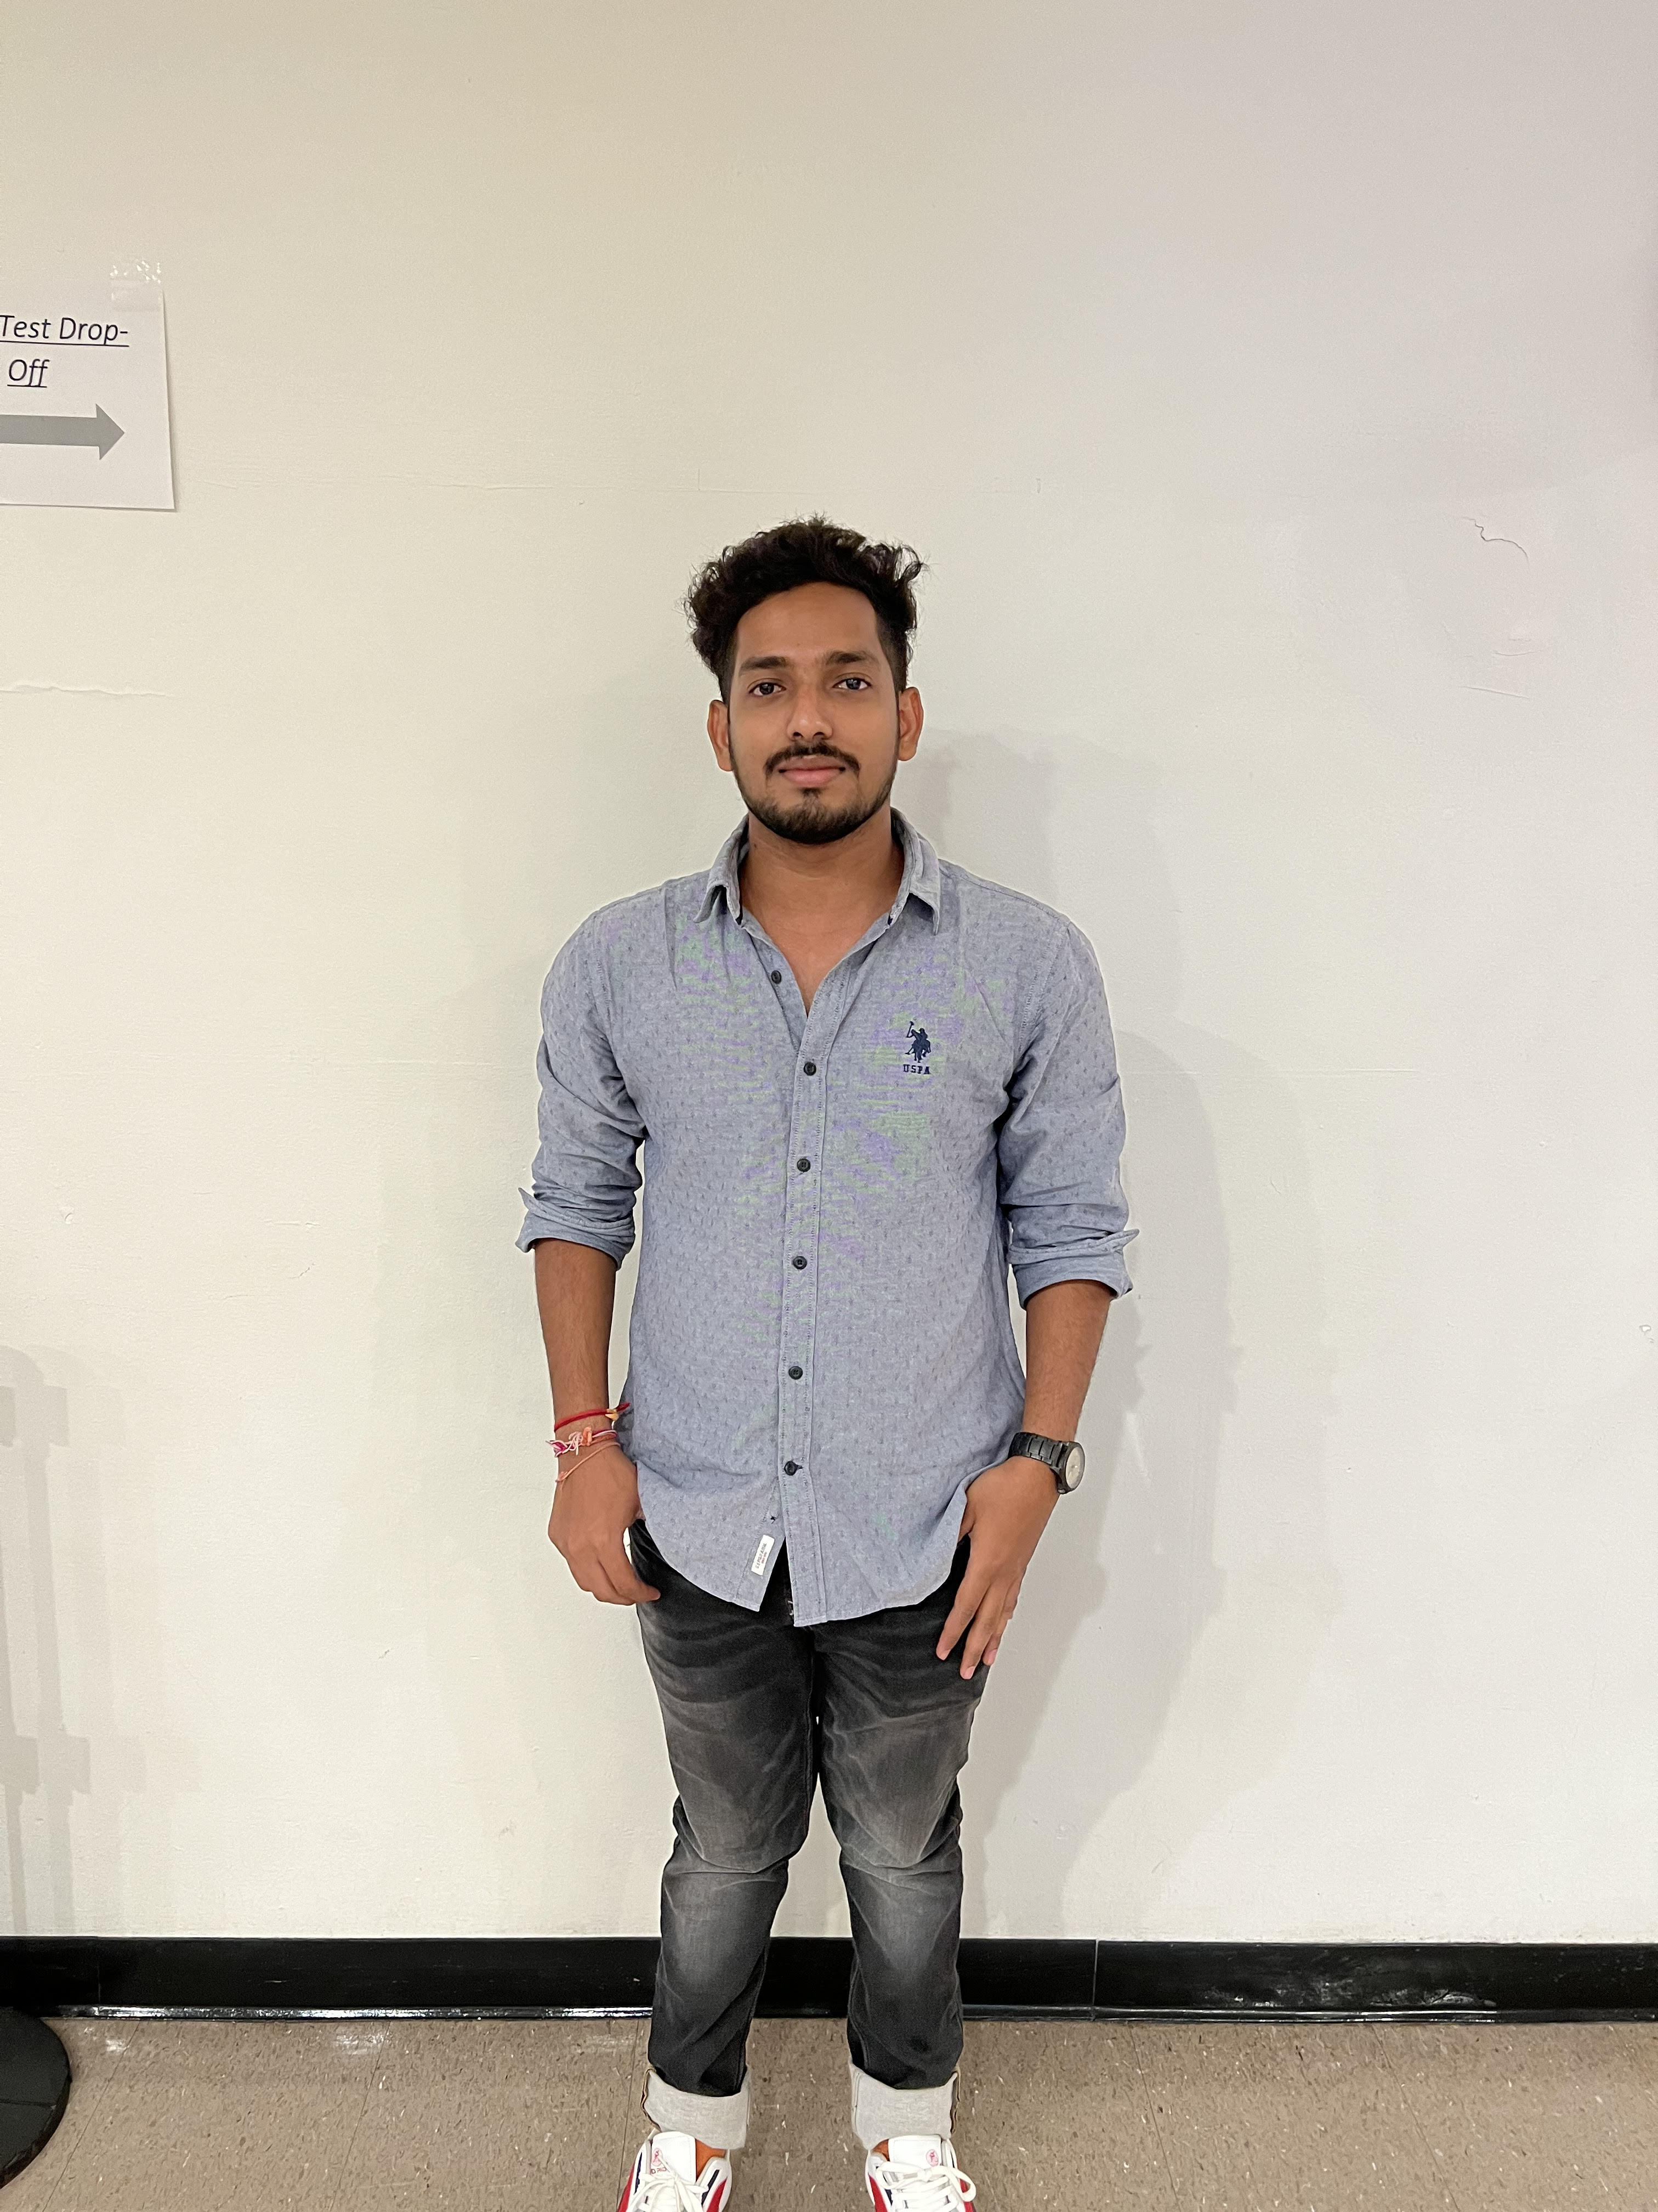


Team Member Roles and Responsibilities
Vamshi
(Product manager)
Alekhya
(Tester)
Hanith atluri
(Developer)

Slide 5



Team Members Roles and Responsibilities
Anusha Nunna
(Developer)
Venkatesh
(Quality Analyst)
Reshma Gonu
(Developer)

Slide 6

Improvements made from Professor Feedback from Sprint- 01 to Sprint - 05
Rewriting of sprint schedule
Need to correct the role name in team member’s slide.
In response to the professor's feedback, we've made the necessary adjustments to the role name this time.
Need to provide a verbal explanation while demonstrating the functionality of an MVP application.
→During the previous sprint, our MVP demo lacked audio. However, this time, we've rectified this issue by including both audio and a functional video.
Need to present good team velocity chart and burndown chart, required to explain about velocity report and burndown chart in the video presentation.
We have addressed the professor's feedback by providing an explanation of the velocity report and burndown chart.
It is necessary to include the story point estimate and note that the acceptance criteria is not presented on a separate slide; rather, it's integrated into the user story itself.
→This time we have mentioned the story point estimate. Also, we mentioned the acceptance criteria in user story.
Require improved diagrams.
→ We have furnished explicit diagrams.

Slide 7
Improvements made from professor feedback from Sprint-06
Need to mention the context for API
As noted by the professor in the feedback for sprint-6, we have provided the context for the API.
Need to change the column name ‘place’ in user stories slide The column name previously labeled as 'place' has now been changed to 'page.'
Need to mention the product backlog slide As per the feedback from the professor, we have included the product backlog slide.
In test cases slide need to rename the column name from ‘Key’ to ‘user story id / test id’ In response to the professor's feedback, the column formerly named 'Key' has been updated to 'user story id / test id’
Need to mention all sprints velocity Average in velocity report, Also need detailed explanation about velocity report and burndown chart
In accordance with the professor's feedback, we have included the average velocity of all sprints in the velocity report. Additionally, a comprehensive explanation of the velocity report and burn-down chart is required.
Need to summarize about user stories and test cases
This time, we have provided clear details regarding both the user stories and test cases.
Need to mention Committed ration for all sprints not for single sprint In response to the professor's feedback, we have documented the ratio for all sprints.

Slide 8

Project Description

Slide 9

Project Description
Project Name: | SARS Covid-19 detection through AI
Team: | Mission Possible
Project description: | For users Who want to know their feedback on covid-19 reports the let it free Is a web app That checks users reports and provides the accurate result Unlike if users not able to go hospitals in the covid-19 situation Our application will help them to submit their reports and they can get their accurate result. Based on their result they can order the medical kit and they can make an appointment to the doctors as well.
Benefits outcomes: | It the users can use our application they can easily get their covid-19 accurate feedback. Based on that they can order the tool kit and they can take the precautions s well.
Github link: | https://github.com/htmw/2023S-Team4/wiki

Slide 10
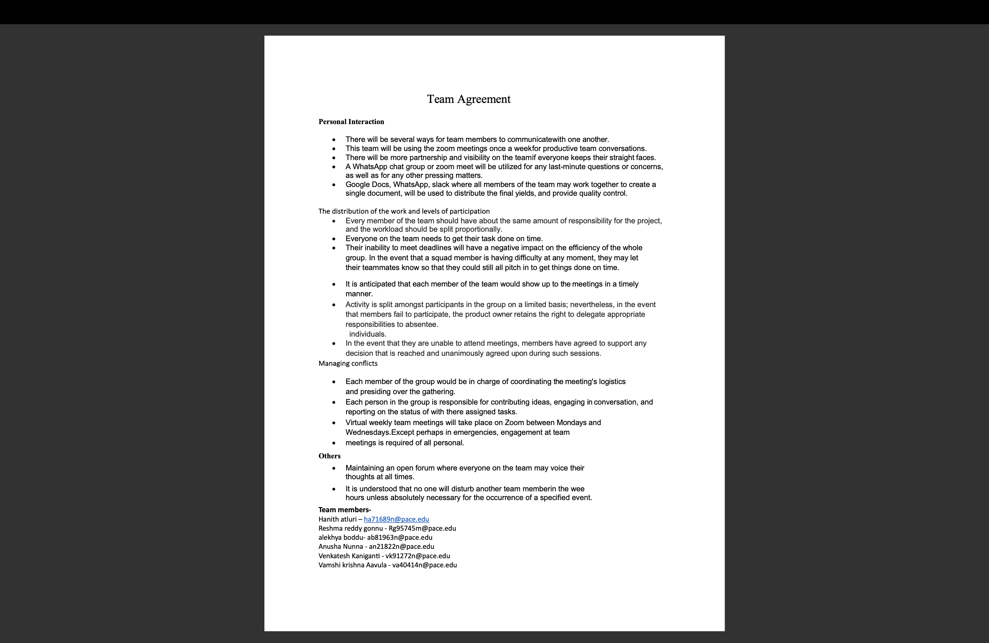
Team 4 - Mission Possible Team working agreement

Slide 11

Personas (at least 3)

Slide 12
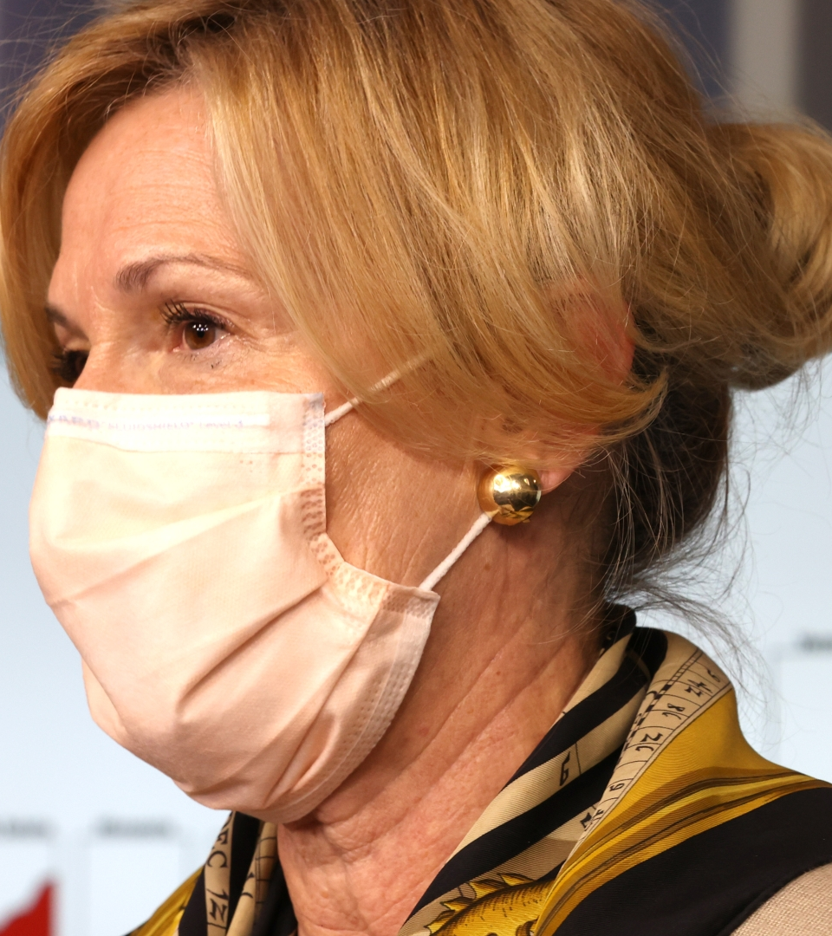
Persona-1
Name: SWATHI
AGE: 38 YEARS
GENDER: FEMALE
Swathi is a 38-year-old professional in the healthcare field. She is passionate about public health and keeps up to date on global health concerns. She has been actively seeking correct and up-to-date information to keep informed and make informed judgments since the COVID-19 pandemic began.
Swathi begins her day by reviewing the COVID-19 data in real time. She launches the app and sees a world map with color-coded sections reflecting the intensity of the pandemic on the dashboard. She moves through other areas to see specific statistics, trends, and immunization rates. Swathi can understand the facts at a glance thanks to the application's graphical representations.

Slide 13
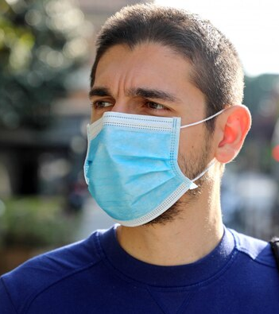
Persona-2
Name: ASHER
AGE: 35 YEARS
GENDER: MALE
Asher is a 35-year-old man who works a difficult job and lives a hectic lifestyle. Alex is driven to take control of their health and well-being after recently being diagnosed with a chronic medical condition. They have a great desire to better understand their medical condition and make informed self-care decisions.
Asher enters into the health education platform after obtaining their diagnosis. The system prompts customers to enter their medical condition and interests, and then tailors the content to them. Asher gets a tailored feed of articles, videos, and infographics pertaining to their illness on the platform's homepage. The articles cover a wide range of issues, from symptom recognition to disease management through lifestyle changes.

Slide 14
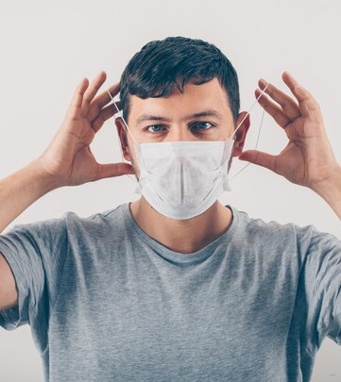
Persona-3
Name: CHARLES
AGE: 30 YEARS
GENDER: FEMALE
CHARLES is a 30-year-old professional who manages a demanding job schedule as well as a personal life. Charles, who is concerned about maintaining a healthy lifestyle, conducts self-assessments on a regular basis to evaluate several areas of well-being, including physical and mental health.
Charles checks into the self-assessment site after a long workweek. Any active checkboxes are highlighted by the Boolean check system, suggesting specific areas that may require attention. If an active checkbox is found, a pop-up notification appears with a brief summary and recommendations for further steps. Charles likes the quick response, which allows for timely responses to health-related concerns.

Slide 15
MVP
Home Page
Prediction
History of Prediction
Personal data - of a user
Book a doctor appointment - User
Active cases in a specified region
Self check assessment – user

Slide 16







Algorithms & Technologies
16

Slide 17
Algorithm
This is a real-time object detection algorithm that identifies specific objects in images. This machine learning algorithm uses features learned by a deep convolutional neural network to detect an object. Object classification systems are used by Artificial Intelligence (AI) programs to perceive specific objects in a class as subjects of interest. The systems sort objects in images into groups where objects with similar characteristics are placed together, while others are neglected unless programmed to do otherwise. This is a Convolutional Neural Network (CNN) for performing object detection in real-time. CNNs are classifier-based systems that can process input images as structured arrays of data and recognize patterns between them. This has the advantage of being much faster than other networks and still maintains accuracy. It allows the model to look at the whole image at test time, so its predictions are informed by the global context in the image. All other convolutional neural network algorithms “score” regions based on their similarities to predefined classes. High-scoring regions are noted as positive detections of whatever class they most closely identify with.

Slide 18
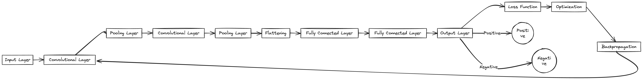
CNN - Algorithm

Slide 19

diagrams

Slide 20



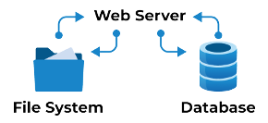
Upload Image
Upload Image
Display Results
Display Results
Users
Frontend
Web Server
File System
Database
Backend
Conceptual Architecture Diagram

Slide 21
START
Upload Dataset with label
Image Preprocessing
Feature extraction using CNN
Train CNN
Input Test Image
Classify Test Image
Display Result
STOP
Flow-chart Diagram

Slide 22

Training images with label
Labeled Images
Pre-processing and image-frame conversion
Processed frames
Image preparation for training
Construct and train model
Model Graph
User
Test Image
Test Image
Pre-processing and frame conversion
Trained and saved model
Predicted label
Dataflow Diagram

Slide 23
User
Data Storage
CNN
Create Trainset & Test set
Construct CNN Model
Collect Image
Store Image Files
Extract features
Train Model
Validates evaluated model
Save Model & Weights
Generate performance report
Load pre-trained Model Images
Collect Image
Predict label
Output
Result
Sequence Diagram

Slide 24
Learning Algorithm
Covid Image
Train Model
Train Set
Image Preprocessing
Feature Engineering
Validate Model
Test Set
Predicated Result
System Architecture

Slide 25

Collect Covid Images
Prepare Data for Training
Design & Construct Model
Train Model
Validate & Improve Model
Test Model on New Image
User’s use case Diagram
Analyze the Predicted Result

Slide 26

Sprint 1-4 Recap(CS-691)

Slide 27
Sprint-1
Issue Type | User Story id/Task id | Name | Story Point Estimate
TASK | SC1DTA-1 | Prepare the presentation for deliverable 1 | 2
TASK | SC1DTA-2 | Formation of team | 2
TASK | SC1DTA-3 | Set up regular weekly meetings | 2
TASK | SC1DTA-4 | Developing a unique project idea and approval from professor | 5
TASK | SC1DTA-5 | Setup development tools (GitHub and Jira) | 5
Initially we divided into the groups and initiated an project idea
Secondly, we started working on our Team working agreement and initiated the tools like slack etc.
In addition, we established our development tools, which we used for seven sprints to build, maintain, and upgrade our communication and web application.

Slide 28
Sprint-2
Issue Type | User Story id/Task id | Name | Story Point Estimate
STORY | SC1DTA-6 | I want to log out as a customer who has logged | 2
STORY | SC1DTA-7 | As a client, I would like to register for the application in order to maintain the uniqueness of my account and to log in using a password, phone number, and email address | 5
STORY | SC1DTA-8 | I want to connect to the app as a customer so that I may use it to keep all my personal data in the local database | 2
TASK | SC1DTA-9 | Create MVP Prototype - Figma ( login and signup pages) | 8
Initially we build an application in Django and when we built the login and signup pages
Connection of data base to the local sever
Prototype of our working application in figma

Slide 29
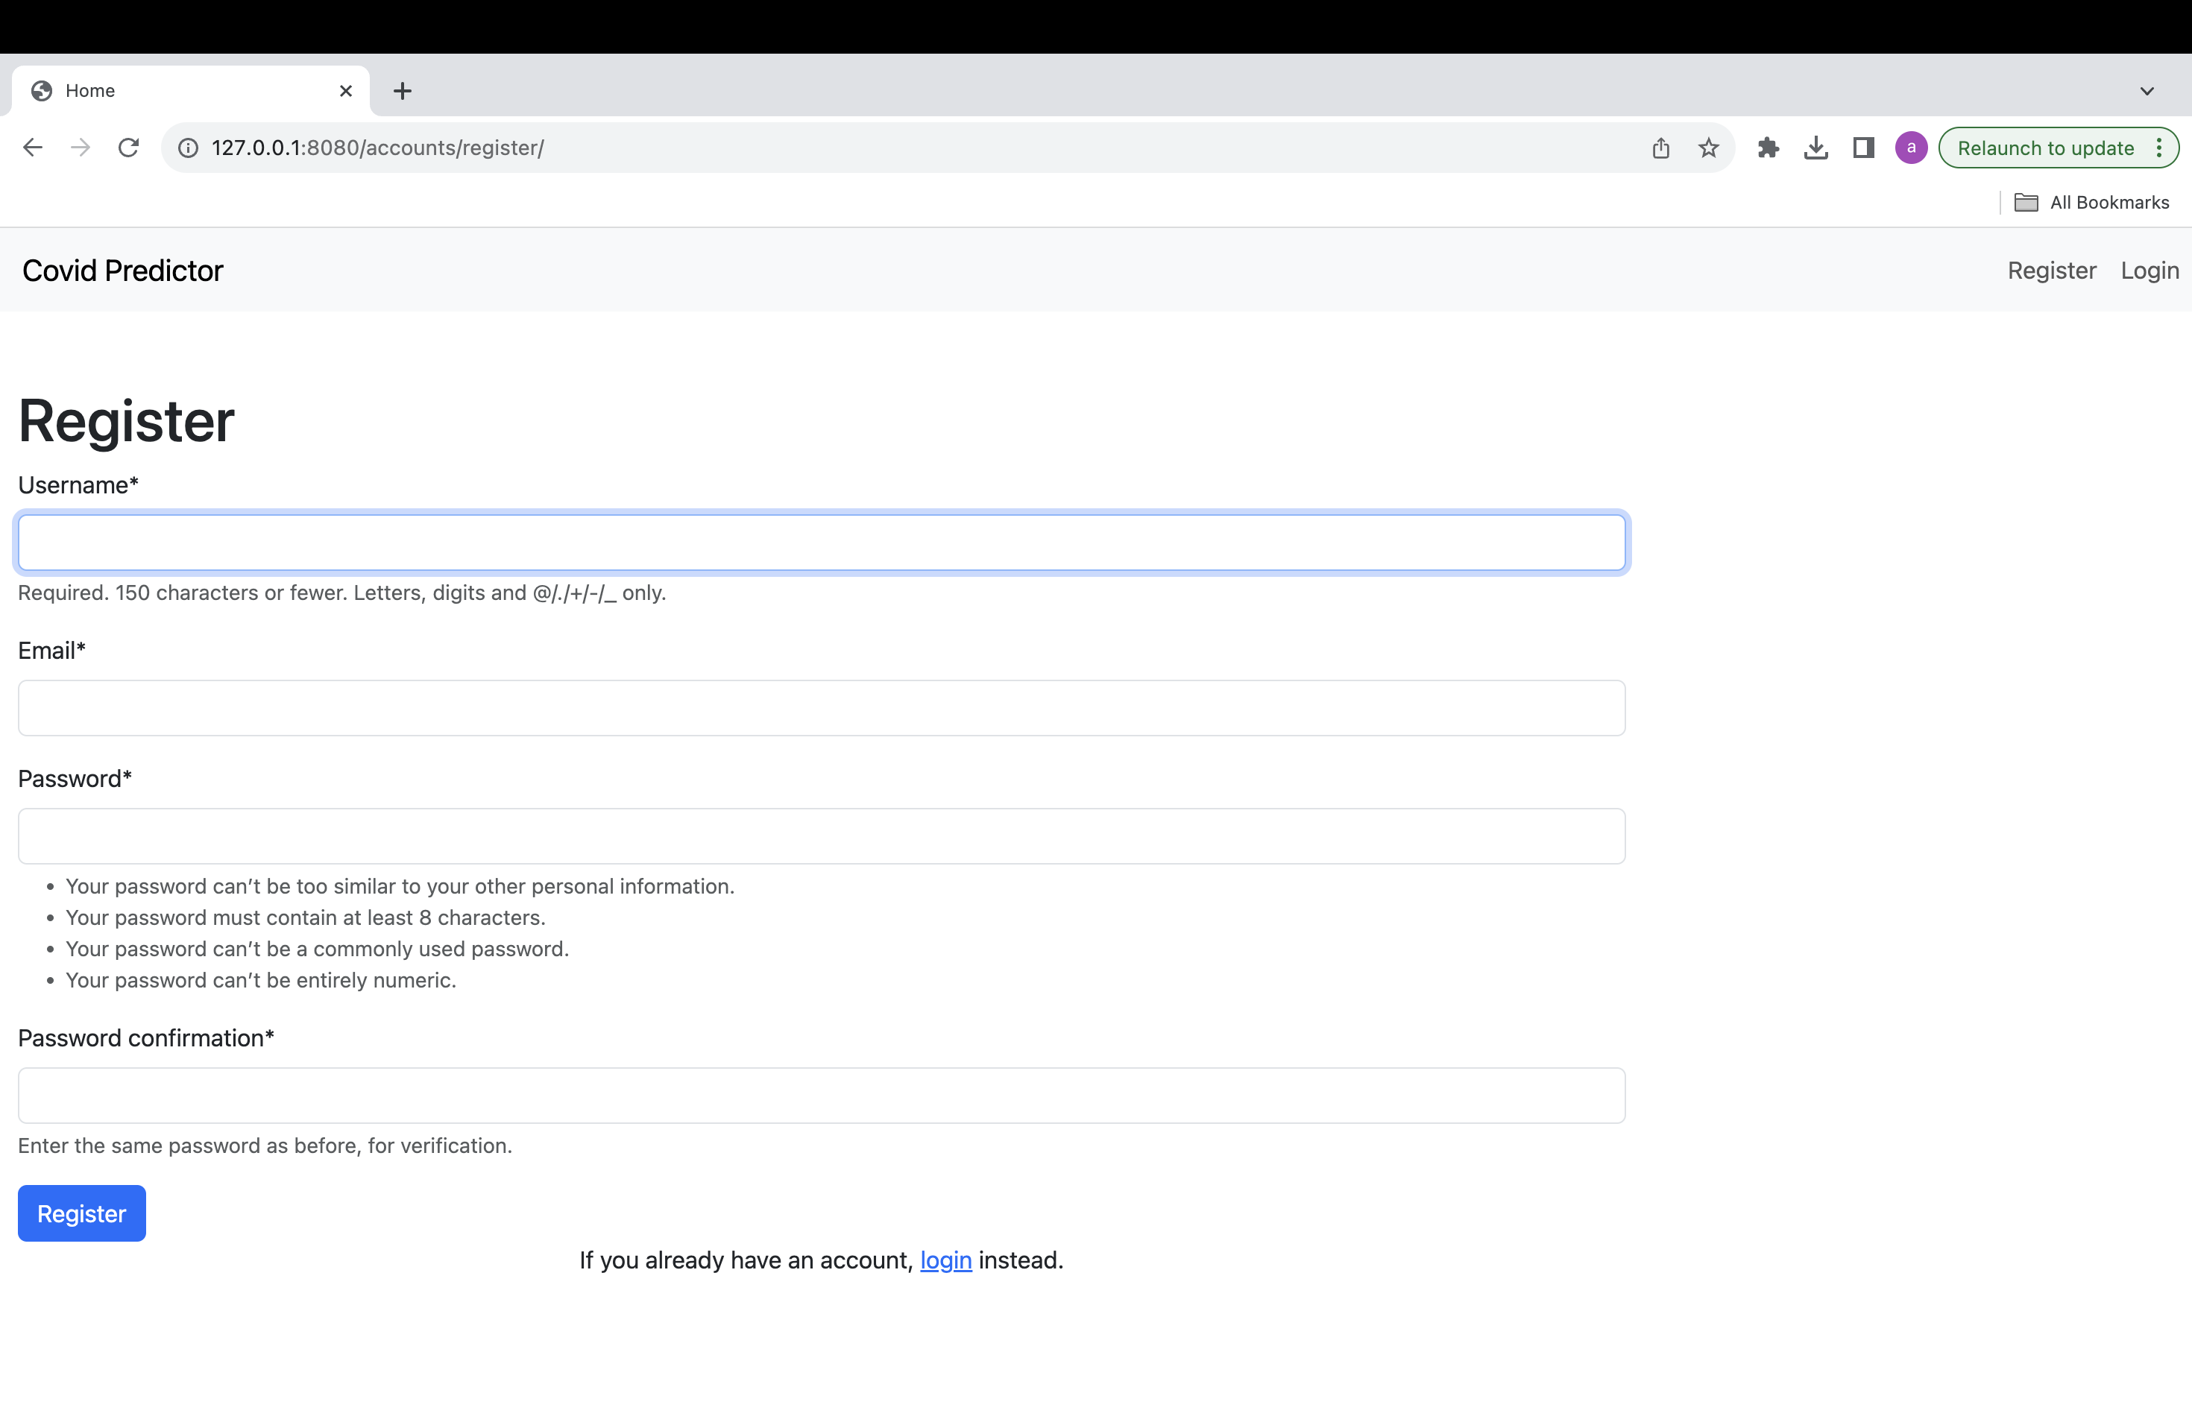
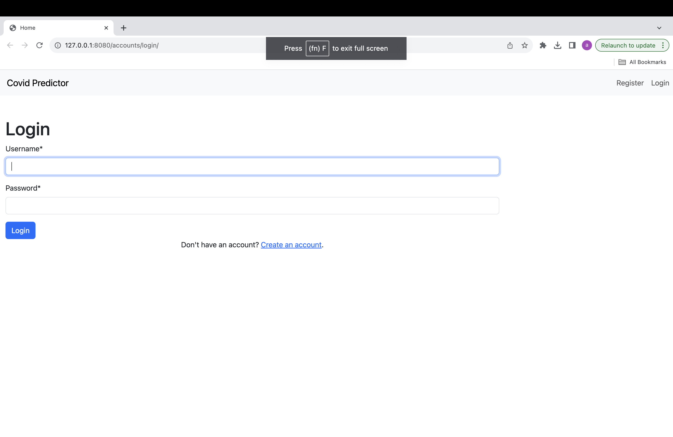
User’s interface of the of creation of account based the restrictions and minimum character requirement for password and email id
User’s first display of the Login page to log-in into their personal account
Login and sign-up pages

Slide 30
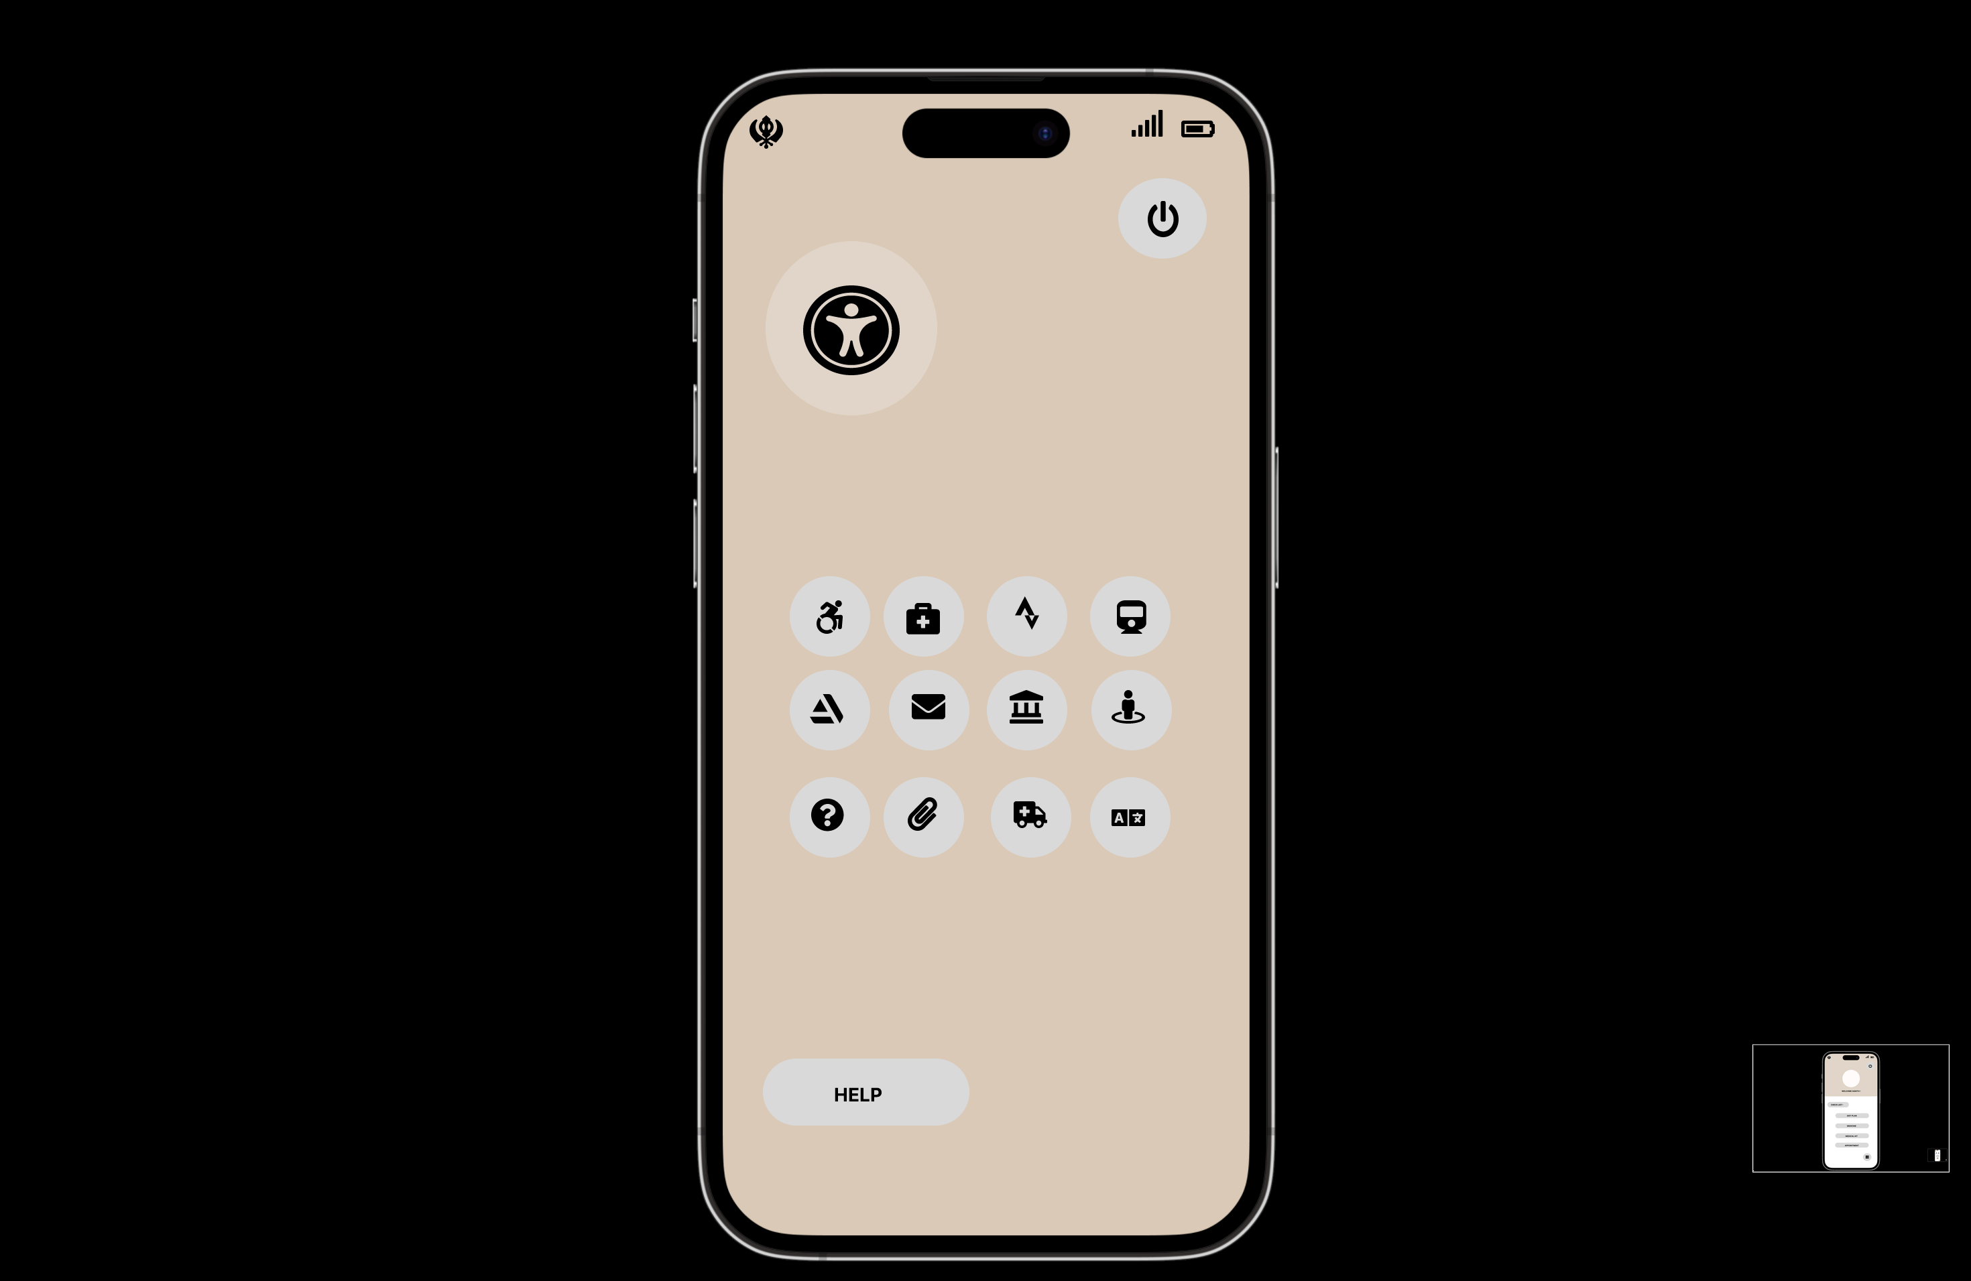
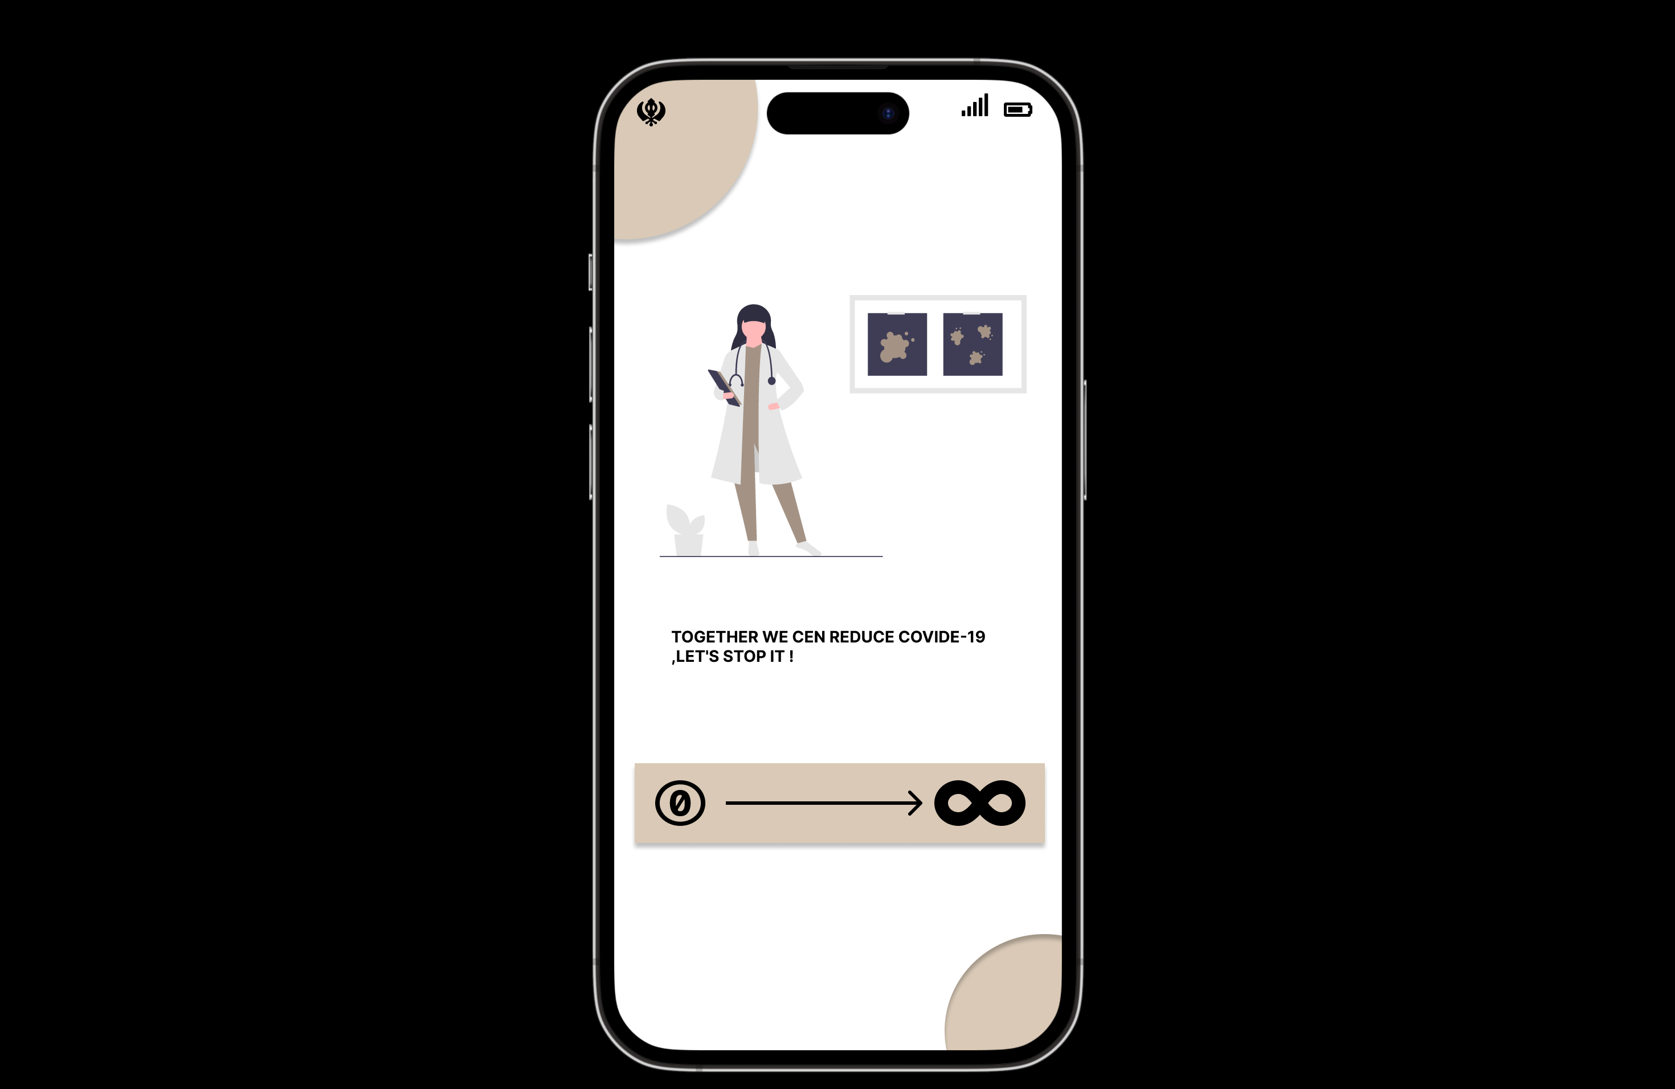
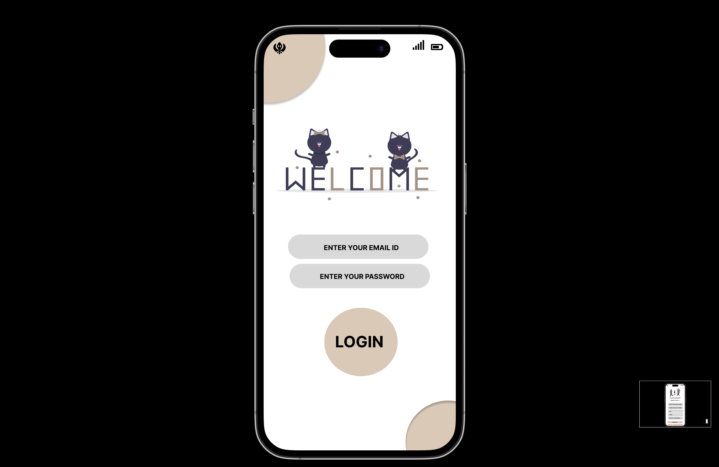
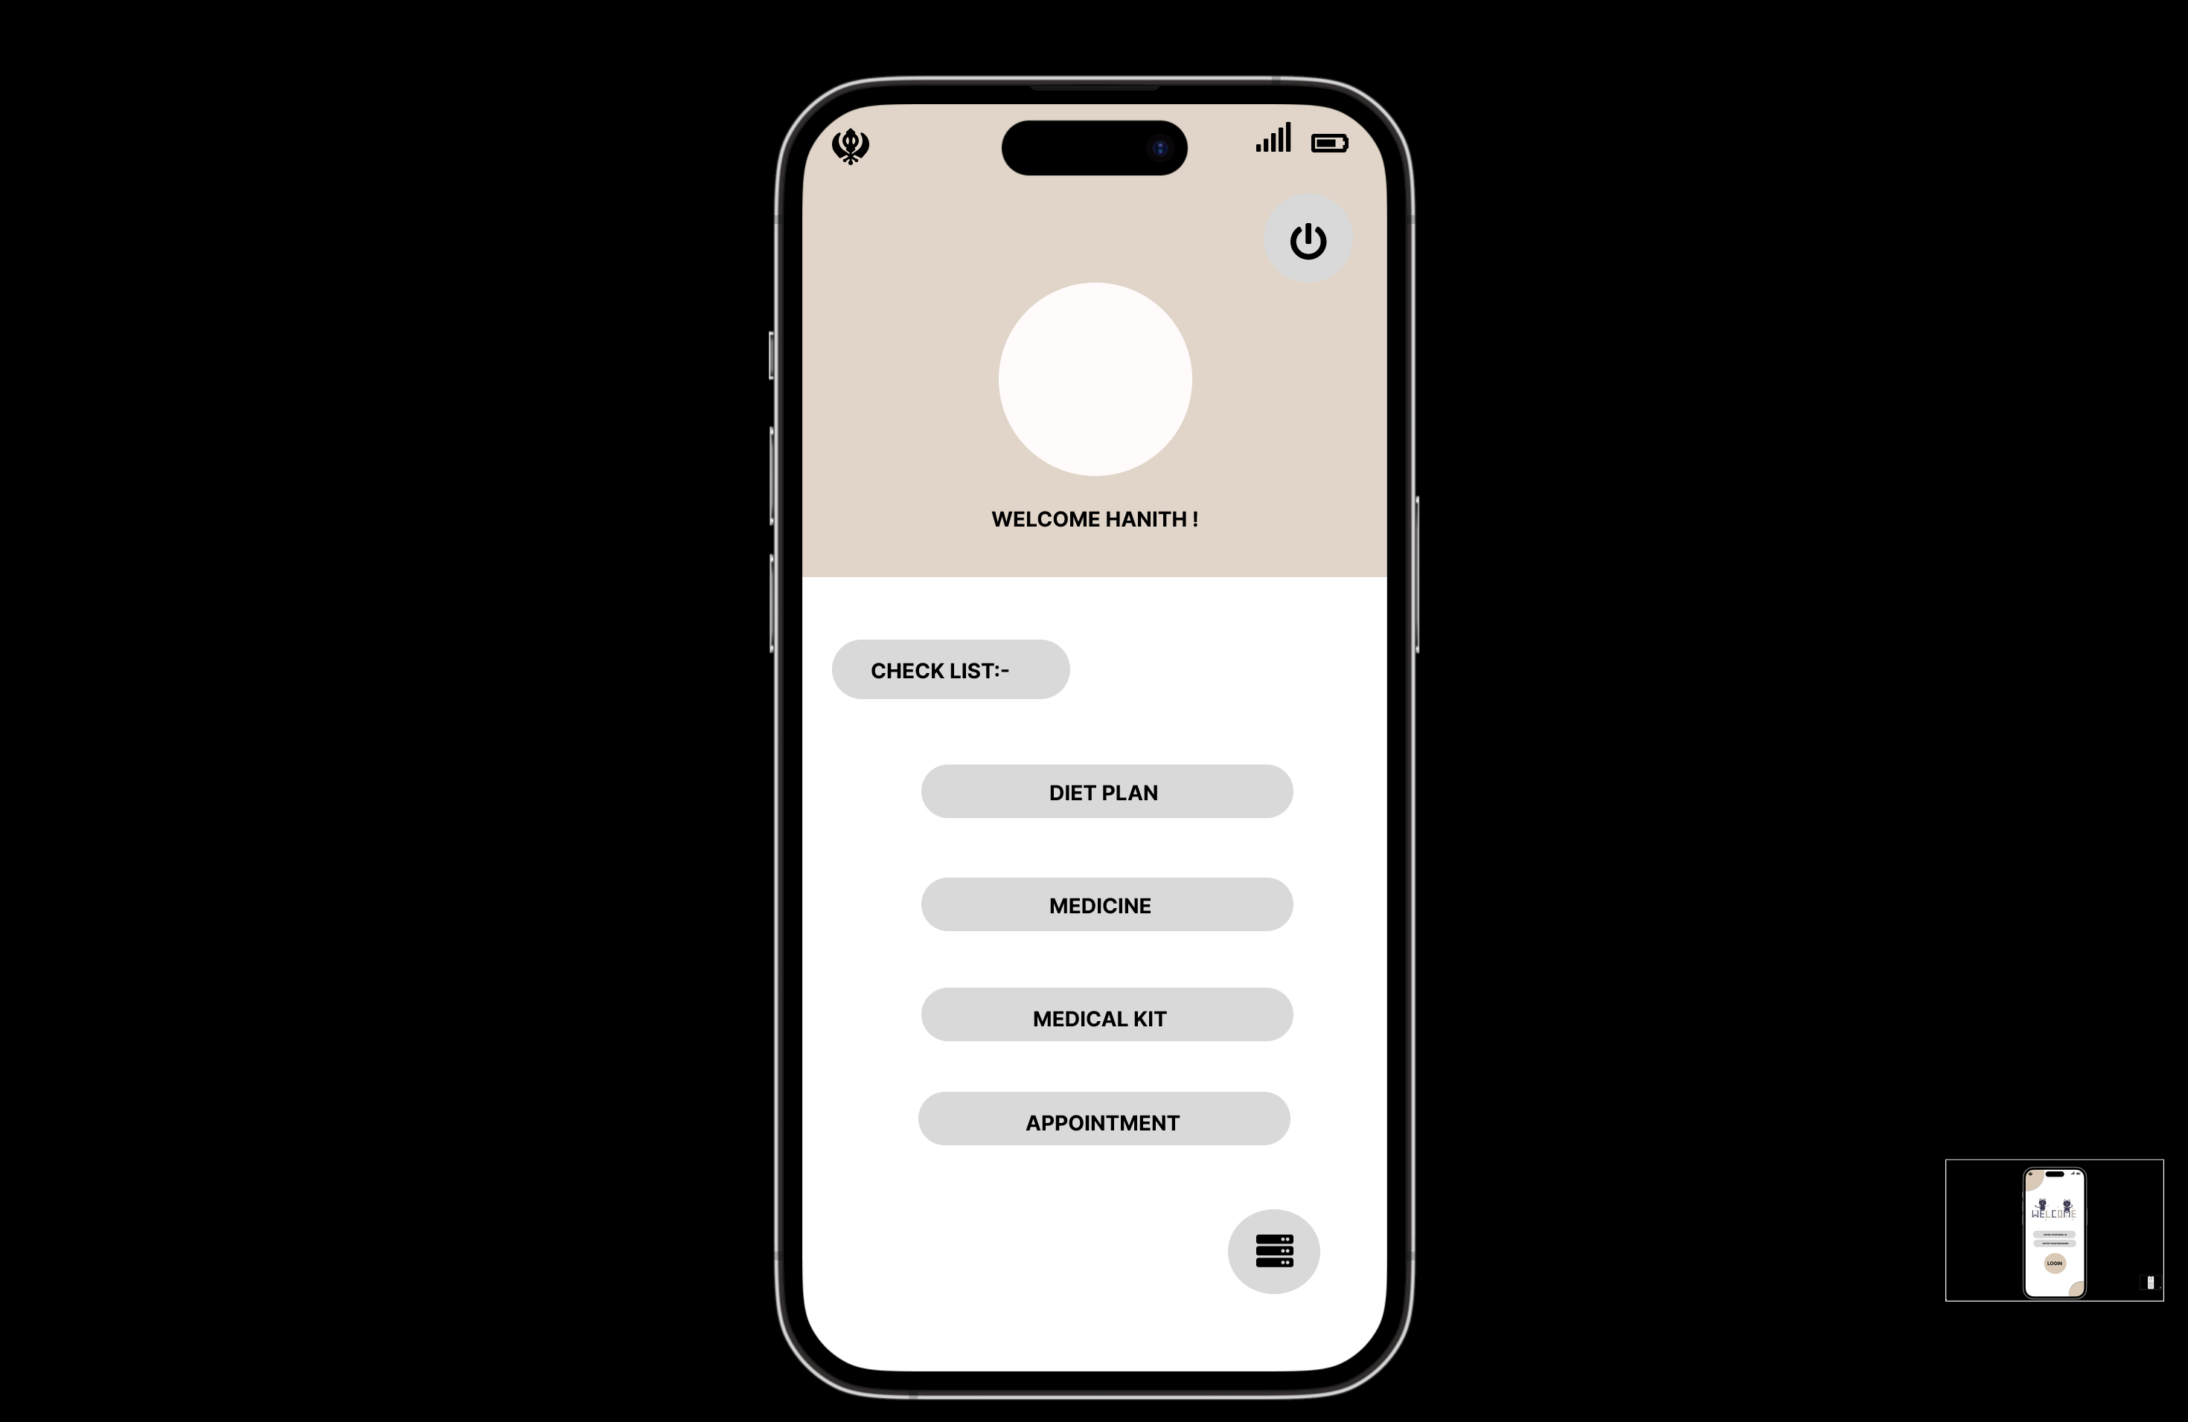
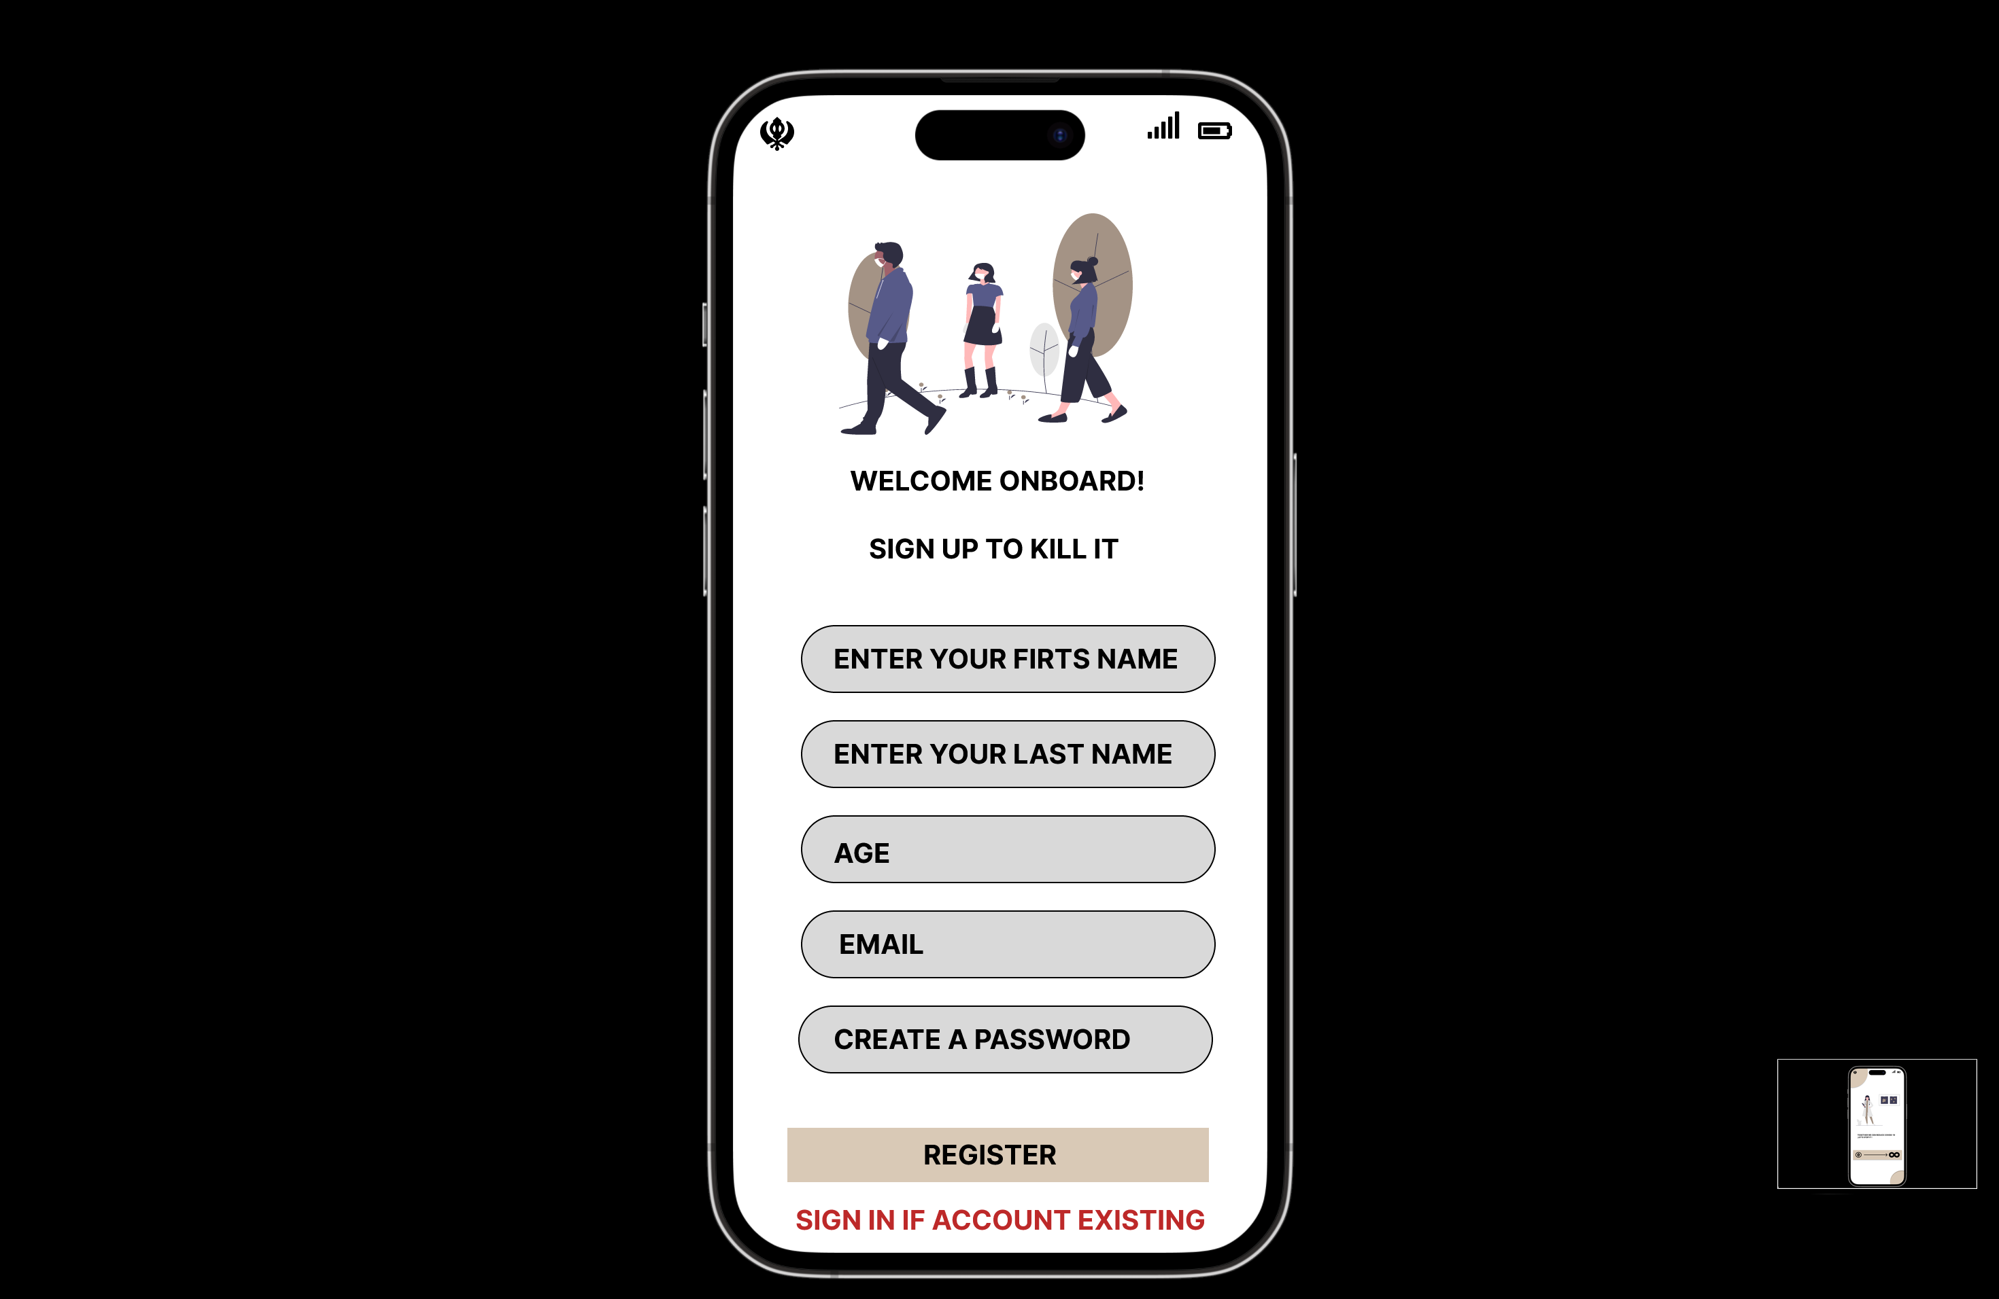
Figma Prototype

Slide 31
Sprint-3
Issue Type | User Story id/Task id | Name | Story Point Estimate
STORY | SC1DTA-10 | I want to know as a user whether my X-ray result will be positive or unfavorable | 5
STORY | SC1DTA-11 | I would like to see the history of uploaded files as a customer | 5
STORY | SC1DTA-12 | I must communicate with a chatbot as a user | 5
TASK | SC1DTA-13 | Technical Paper | 3
In this sprint we have build the core MVP of our project to build an application to predict the covid
Secondary web-page in order to see the uploaded files by the user
Thirdly, communication with the bot so, user can chat with the chat bot
Draft of the technical paper by overlooking into the references and other resources

Slide 32
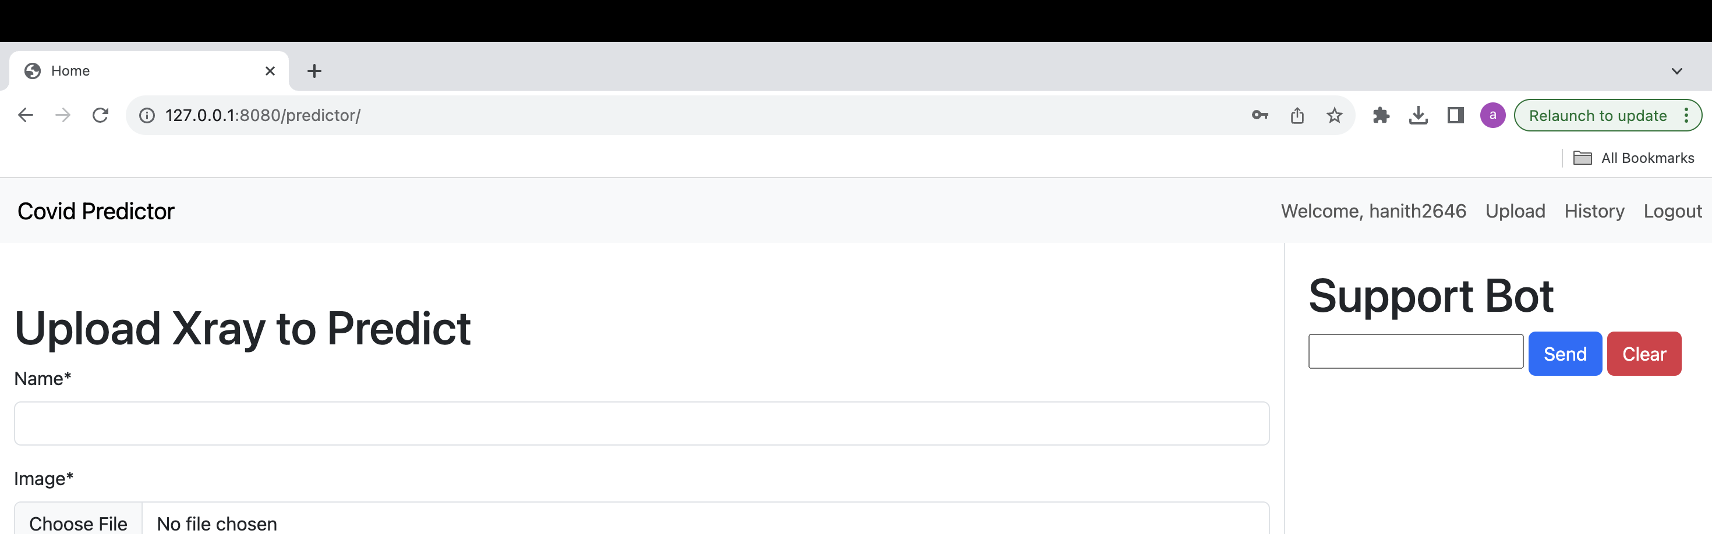
Home page
Home of page of our web application where we can see the additional features included to the application like upload, history, chatbot.

Slide 33
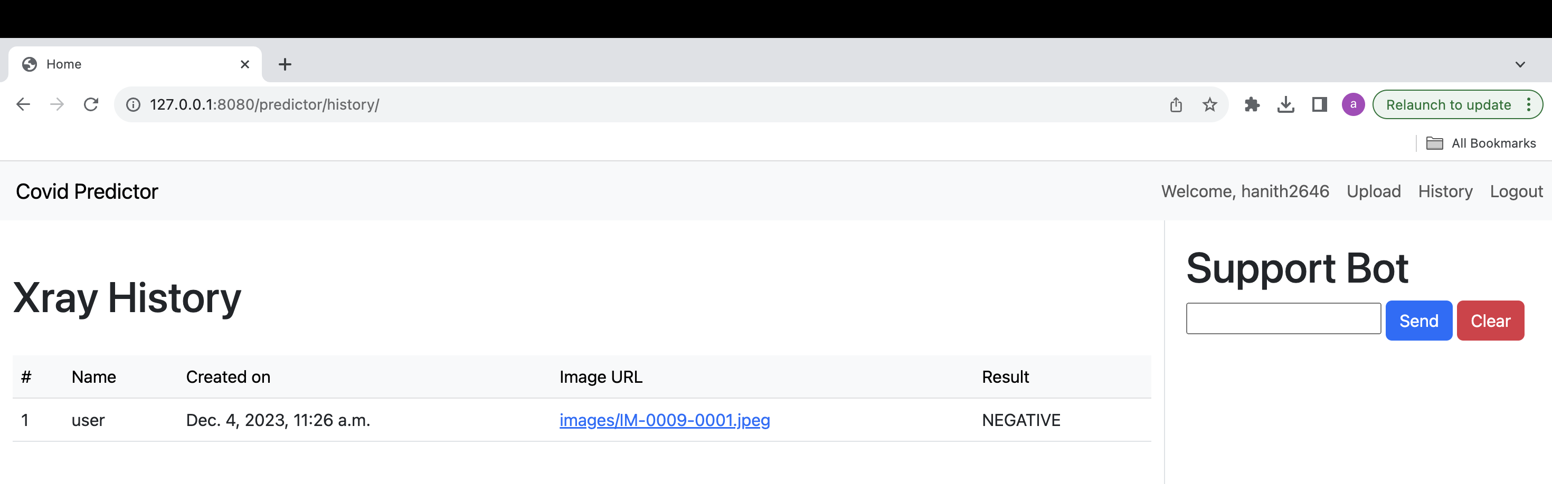
History page
Xray history is an additional web-page where we can see the history of our uploaded Xray's/Ct scans with the user name.

Slide 34
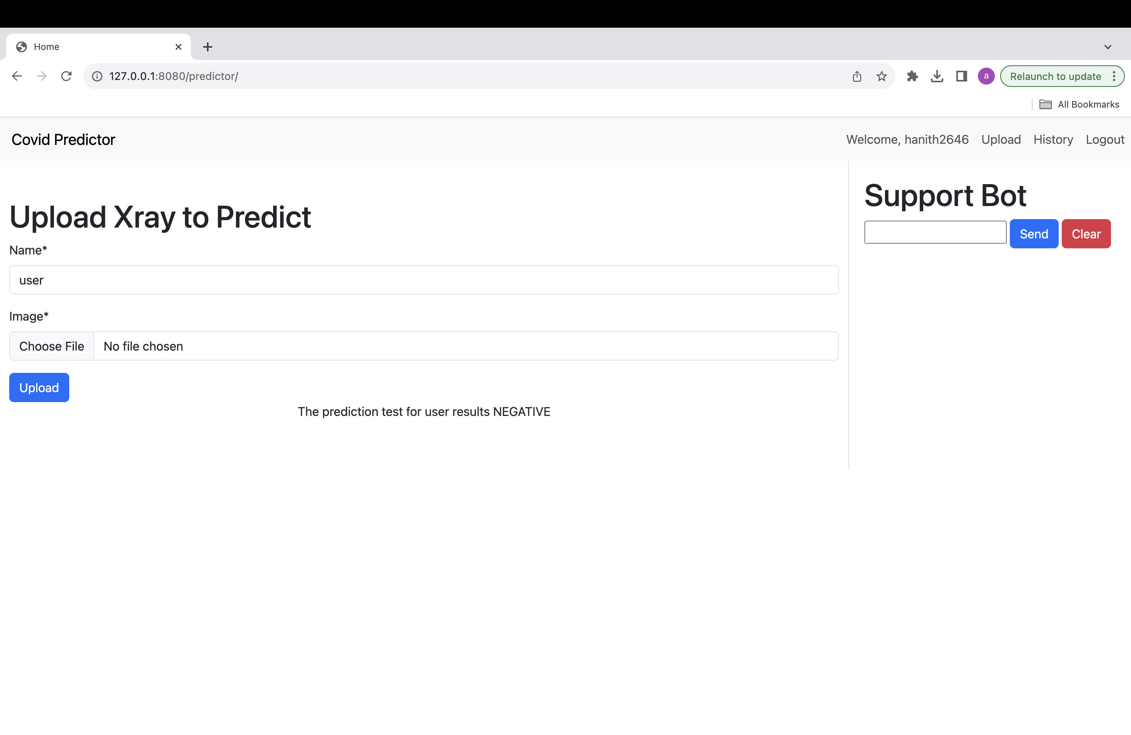
Prediction
To find out whether the Covid analysis of our X-ray picture is positive or negative, we may use the prediction or upload tab.

Slide 35
Sprint-4
Issue Type | User Story id/Task id | Name | Story Point Estimate
STORY | SC1DTA-14 | As a user, I would like to switch between the tabs available in the web application | 2
TASK | SC1DTA-15 | API Documentation | 5
TASK | SC1DTA-16 | Deployment Manual | 5
TASK | SC1DTA-17 | Complete Technical Paper with references and proper format | 8
Implementation of additional web pages
Creation of API documentation for the better store in cloud
An step-by step instruction manual how to run the developed application in the local machine
Complete Technical paper with the additional acknowledgement by seeking into the references and additional sources.

Slide 36
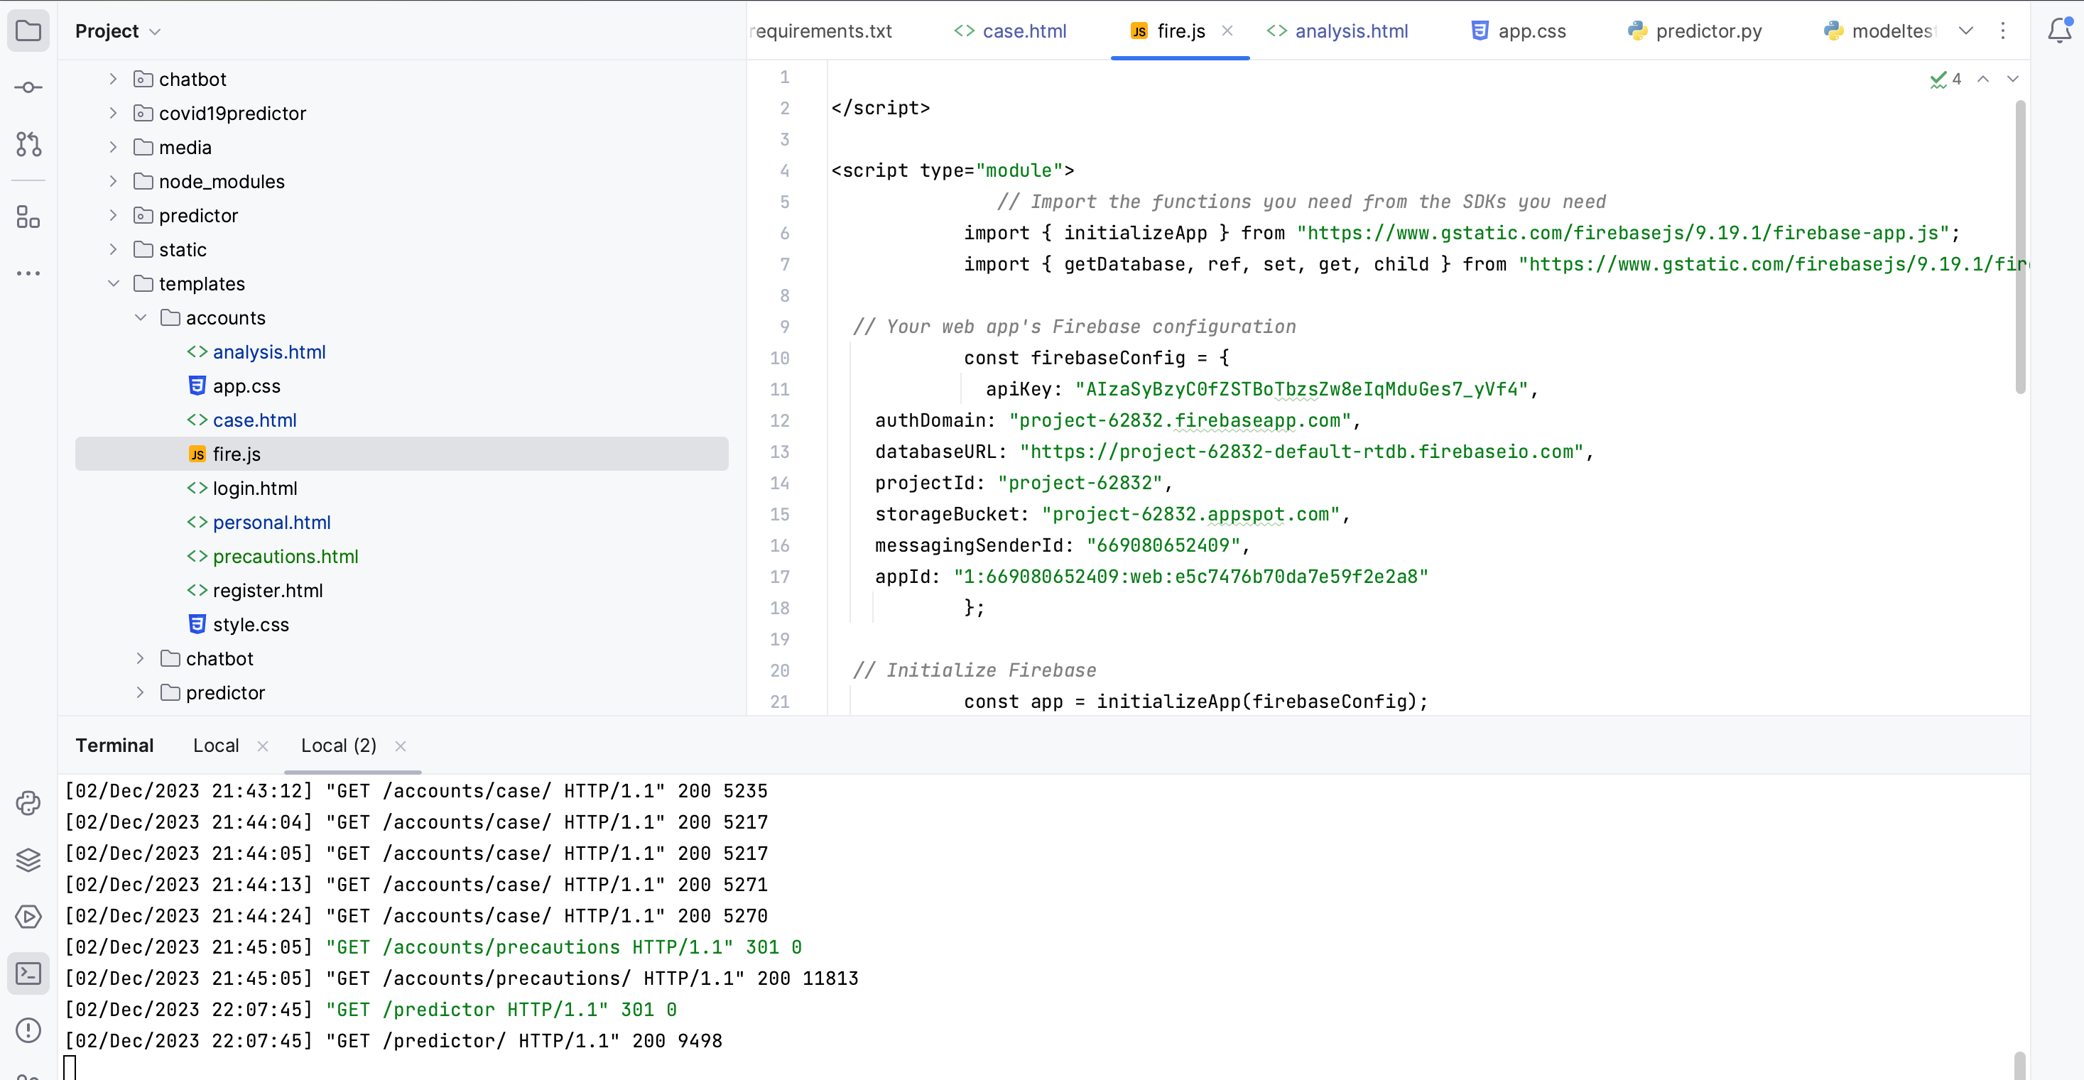
API implementation
API implementation for the the User’s login credentials for the login history which is linked to the firebase database for the cloud and avoid the repetitions.

Slide 37

Sprint 5-6 Recap(CS-692)

Slide 38
Sprint-5
Issue Type | User Story id/Task id | Name | Story Point Estimate
STORY | SC1DTA-18 | As a user, I can chat with the chatbot in order to get some random information | 2
STORY | SC1DTA-19 | As a user , I want to get facilities for that are equipped with the necessary medical supplies and equipment to manage patients with COVID-19 | 2
STORY | SC1DTA-20 | As a user, I want to receive a report indicating whether they have tested positive or negative | 2
TASK | SC1DTA-21 | Transitioning from a Figma features to a web-based application | 5
TASK | SC1DTA-22 | API Documentation | 1
Train of chat bot for better presence of the user performance
Primary information for the doctor from the user side so, to know the pre-information about the user medical history
Accurate prediction of X-ray
API documention of the Additional API’s which were used in the application

Slide 39
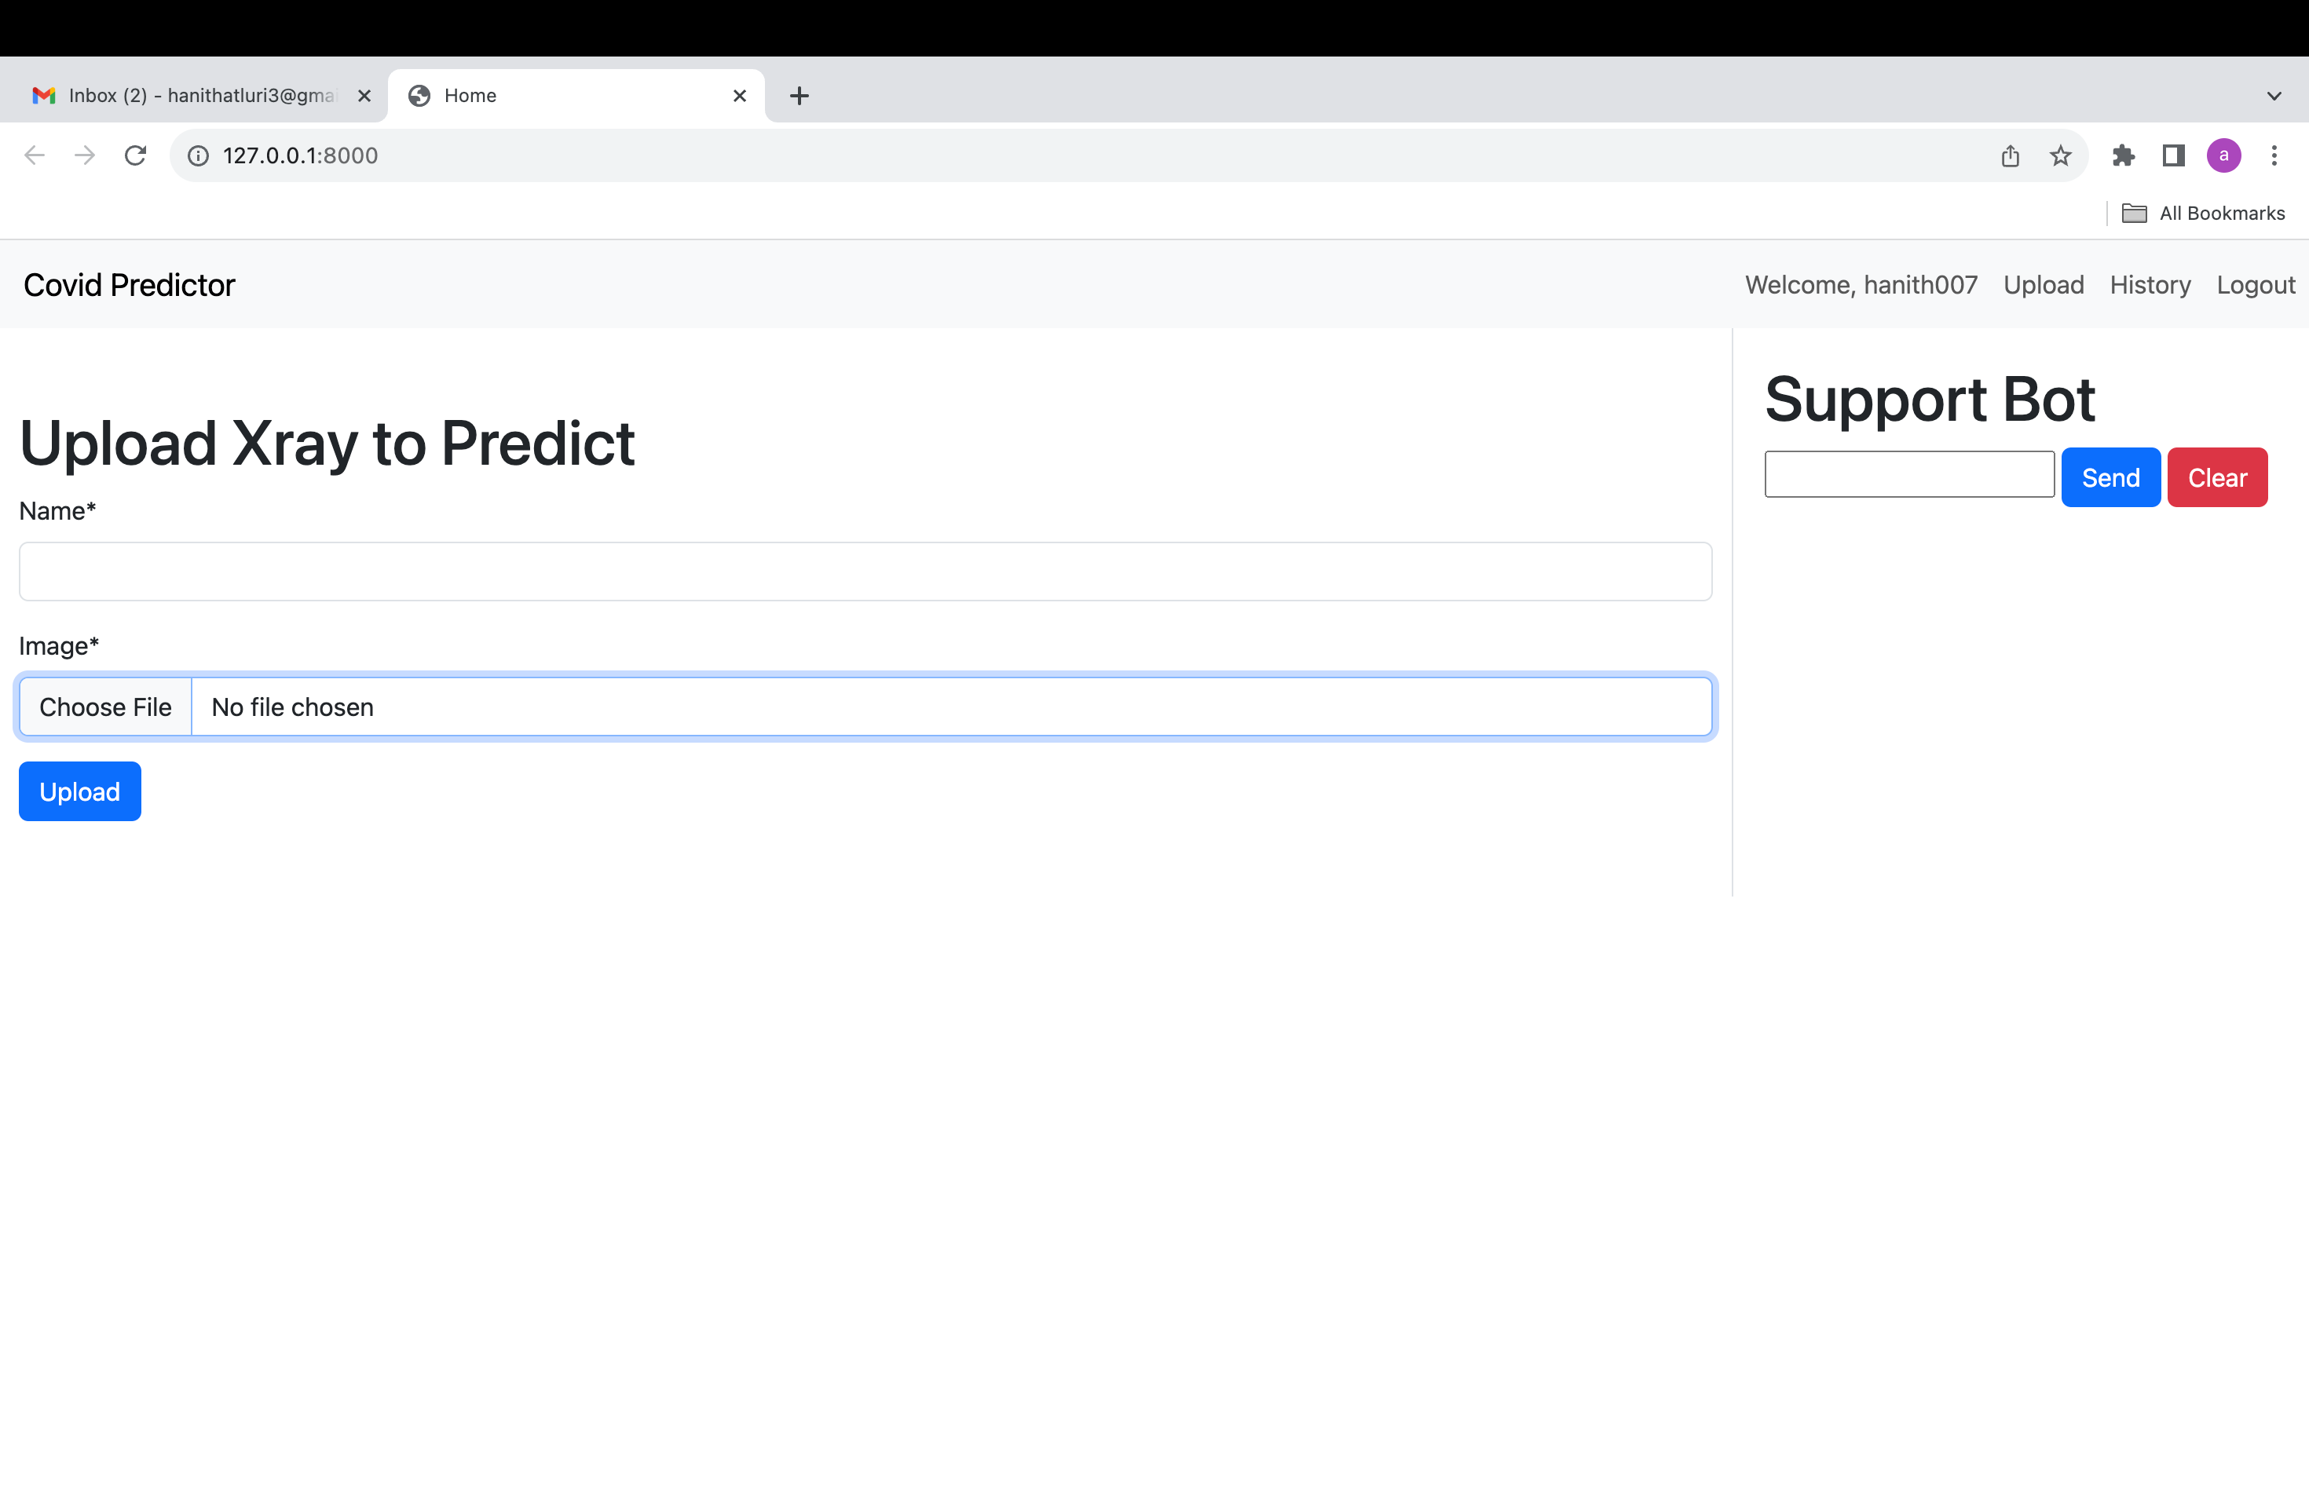
Sprint-05 Updates
During this sprint, we improved the login screen that appears after creating an account, as well as the history, upload, and logout pages, as well as the website's core raw files.

Slide 40
Sprint-6
Issue Type | User Story id/Task id | Name | Story Point Estimate
STORY | SC1DTA-23 | As a user , I want to enter my current medications and dosage, So my medication list is up to date | 2
STORY | SC1DTA-24 | As a user, I want to add my medical history so potential risk factors are documented | 3
STORY | SC1DTA-25 | As a user, I need to schedule an appointment with doctor | 2
STORY | SC1DTA-51 | As a user, I want to receive email reminders 30-mins before my schedule appointments | 3
TASK | SC1DTA-75 | As a user, I need to select the required doctor so, I can get to know the doctor who is specialized in certain organ | 3
TASK | SC1DTA-76 | Deployment Manual | 2
TASK | SC1DTA-202 | Updated version of Technical Paper | 2
Connection of user data to API
Schedule of doctor appointment by the API and earlier confirmation and reminder before 30 mins
Random selection of unique specialized doctor
Deployment manual with how to install the Requirements of the project packages
Revision of technical paper and present the upated version

Slide 41
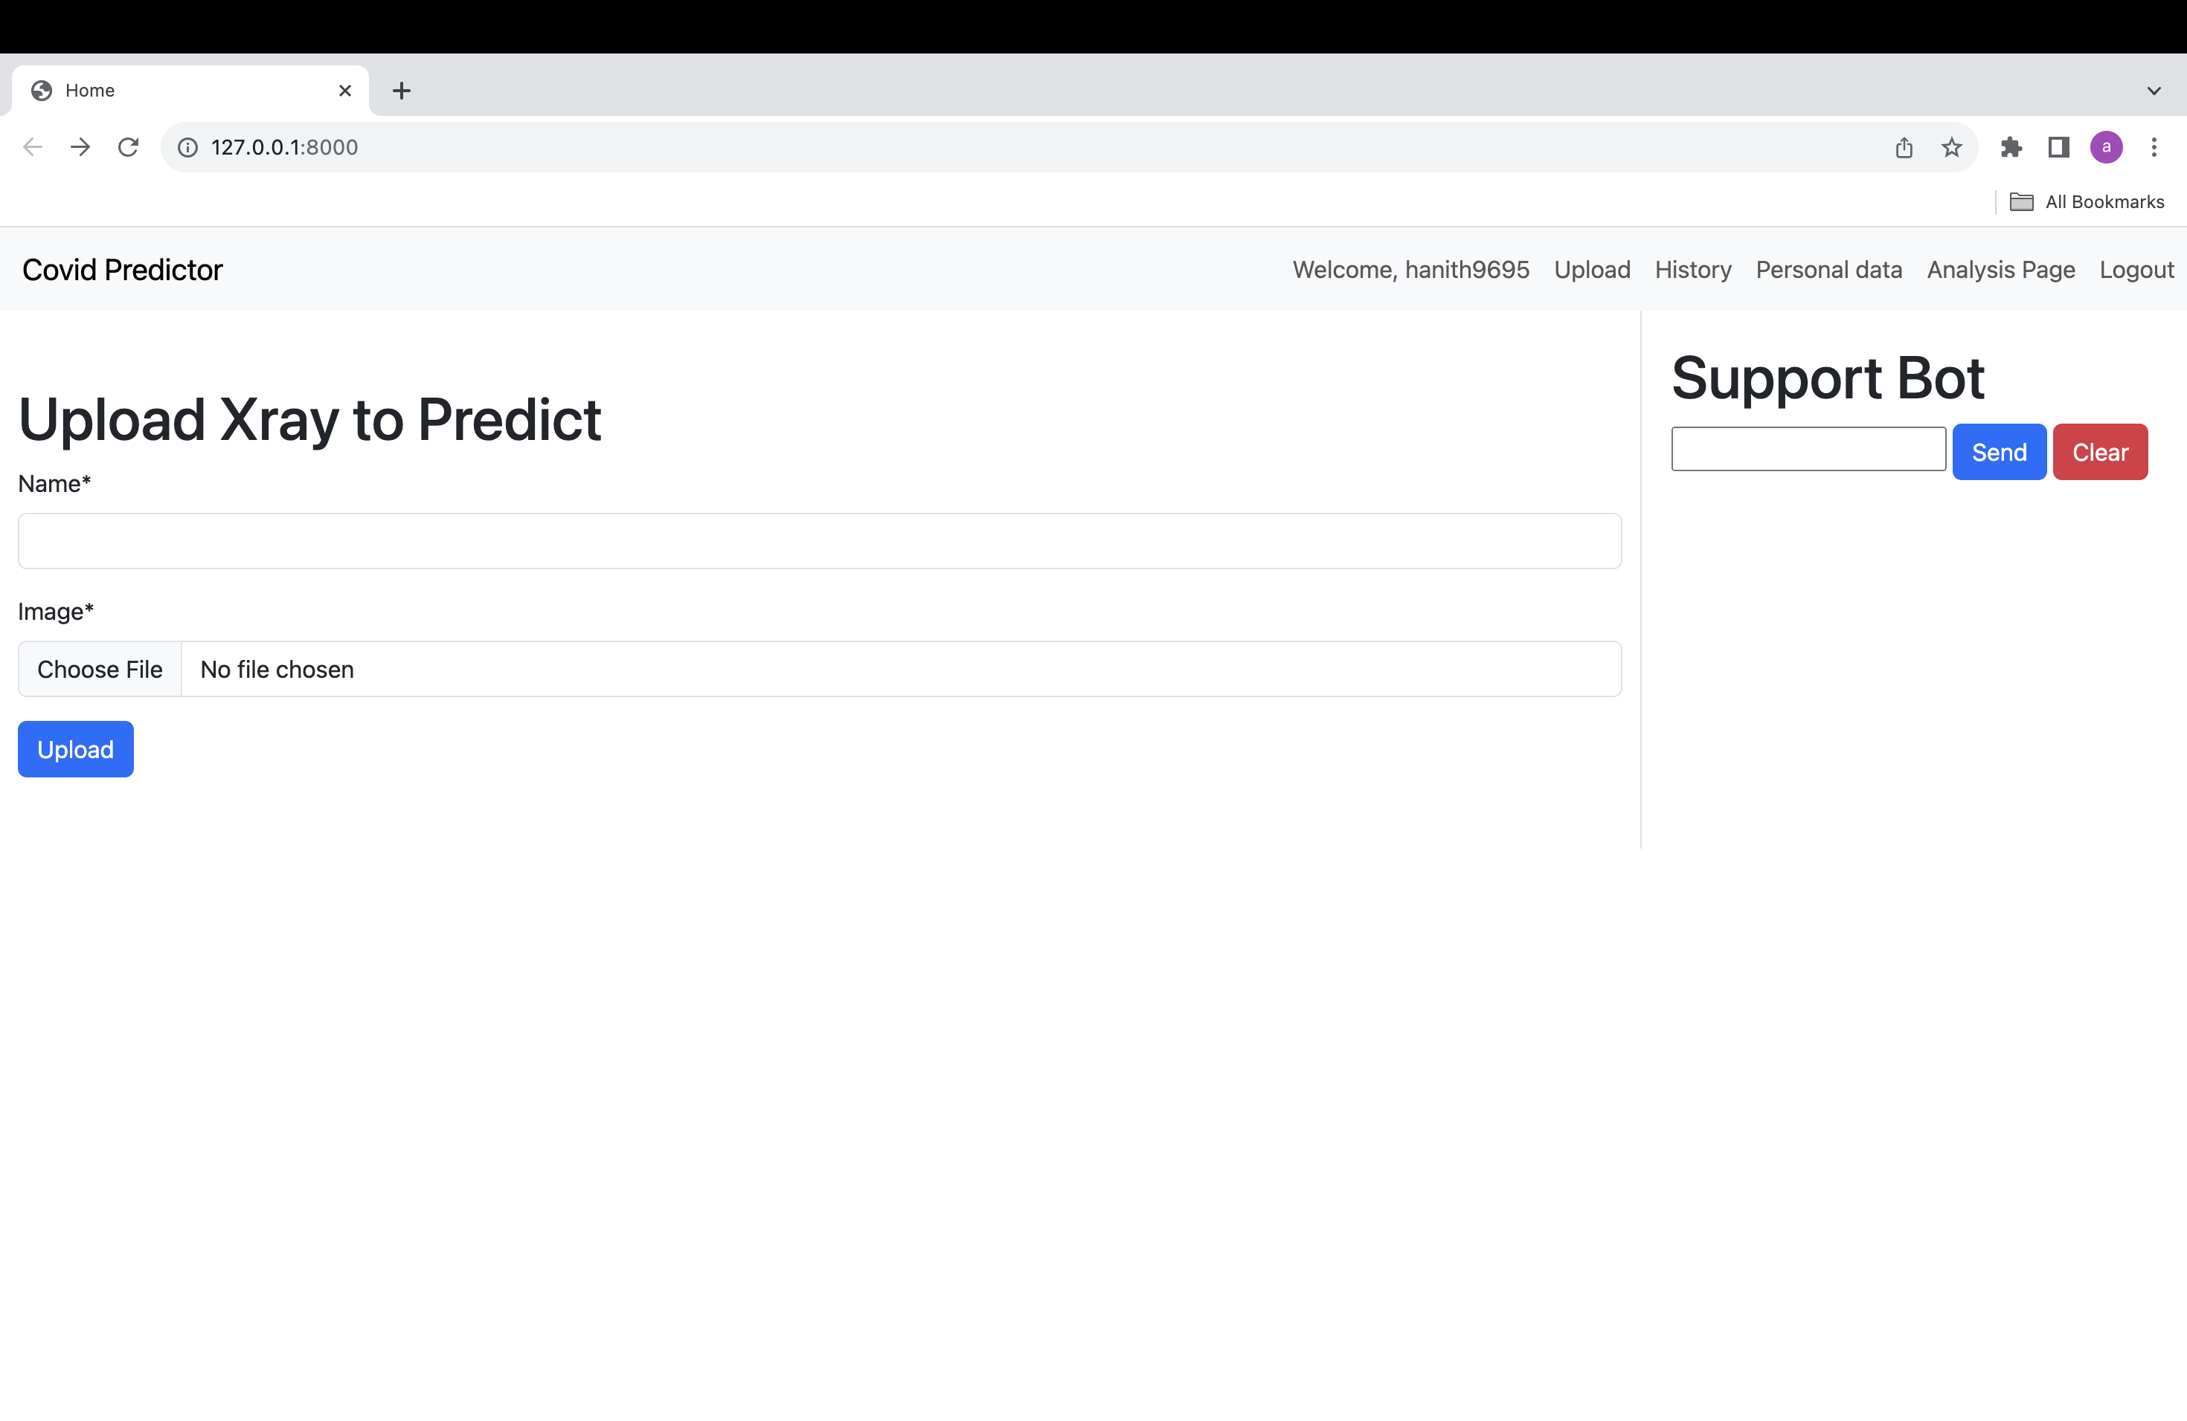
Sprint-06 Updates
By examining the side screenshot, one can see the process of the navigation bar, which incorporates the header along with the other elements shown.

Slide 42
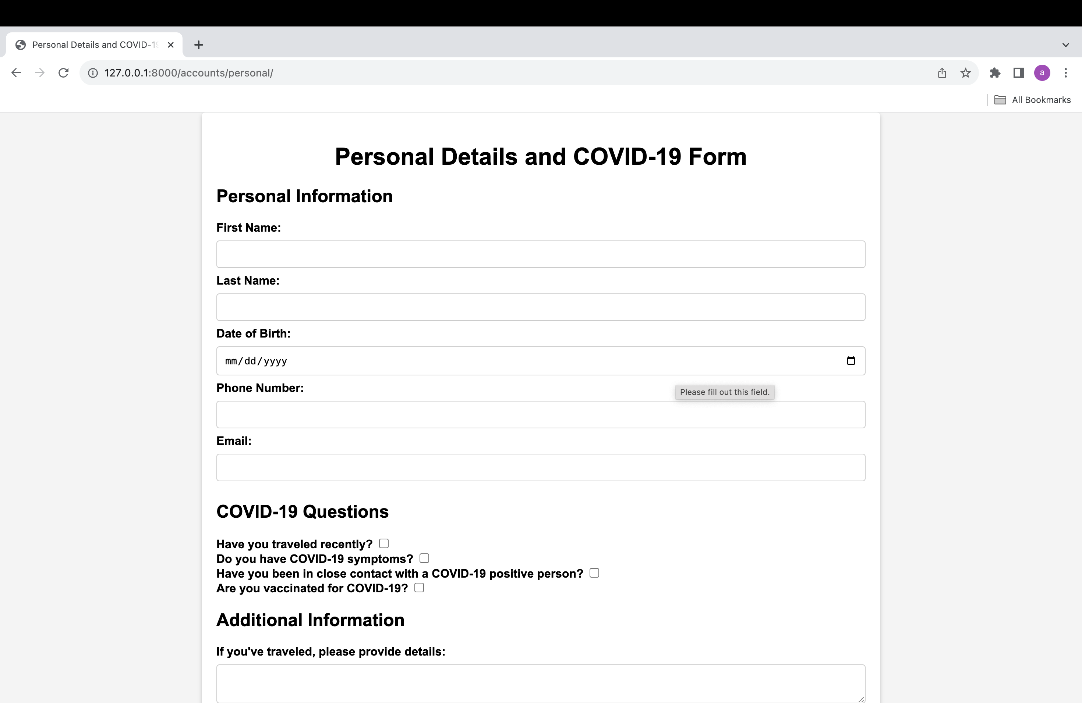
Sprint-06 Updates
As part of this upgrade, we made sure that physicians could get the COVID-19 information form they needed for their exams in an organized and contact-less manner.

Slide 43
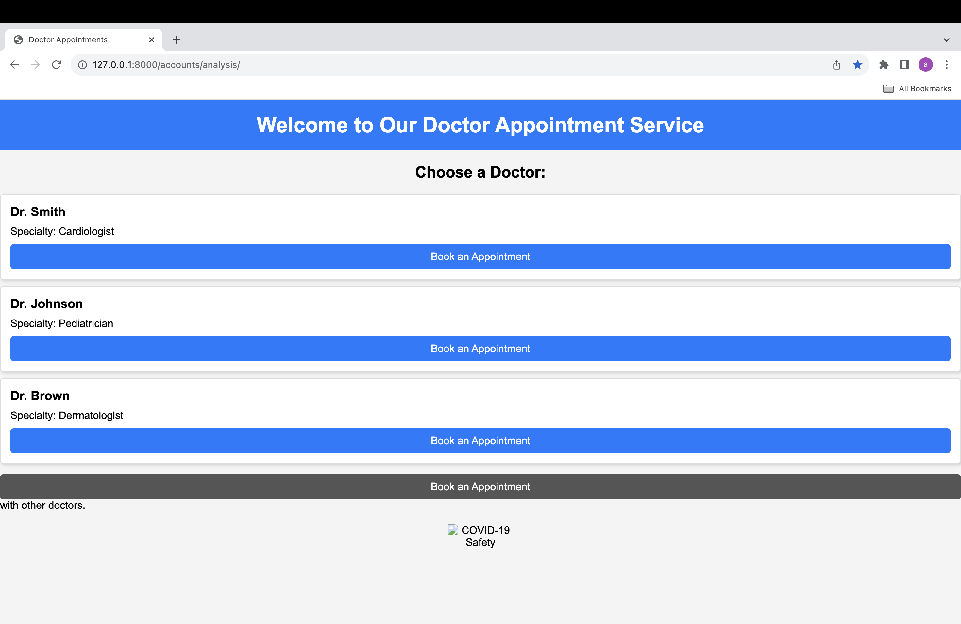
Sprint-06 Updates
In order to have a solid idea of the main details, including the appointment time and planned time, at least 30 minutes in advance, we use this form, which is our doctor's appointment form.

Slide 44
Product backlog
Issue Type | User Story id/ Task id | Name | Story Point Estimate
TASK | SC1DTA-1 | Prepare the presentation for deliverable 1 | 2
TASK | SC1DTA-2 | Formation of team | 2
TASK | SC1DTA-3 | Set up regular weekly meetings | 2
TASK | SC1DTA-4 | Developing a unique project idea and approval from professor | 5
TASK | SC1DTA-5 | Setup development tools (GitHub and Jira) | 5
STORY | SC1DTA-6 | I want to log out as a customer who has logged | 2
STORY | SC1DTA-7 | As a client, I would like to register for the application in order to maintain the uniqueness of my account and to log in using a password, phone number, and email address | 5
STORY | SC1DTA-8 | I want to connect to the app as a customer so that I may use it to keep all my personal data in the local database | 2
TASK | SC1DTA-9 | Create MVP Prototype - Figma ( login and signup pages) | 8
STORY | SC1DTA-10 | I want to know as a user whether my X-ray result will be positive or unfavorable | 5
STORY | SC1DTA-11 | I would like to see the history of uploaded files as a customer | 5
STORY | SC1DTA-12 | I must communicate with a chatbot as a user | 5
TASK | SC1DTA-13 | Technical Paper | 3
STORY | SC1DTA-14 | As a user, I would like to switch between the tabs available in the web application | 2
TASK | SC1DTA-15 | API Documentation | 5
TASK | SC1DTA-16 | Deployment Manual | 5
TASK | SC1DTA-17 | Complete Technical Paper with references and proper format | 8
STORY | SC1DTA-18 | As a user, I can chat with the chatbot in order to get some random information | 2
STORY | SC1DTA-19 | As a user , I want to get facilities for that are equipped with the necessary medical supplies and equipment to manage patients with COVID-19 | 2
STORY | SC1DTA-20 | As a user, I want to receive a report indicating whether they have tested positive or negative | 5
TASK | SC1DTA-21 | Transitioning from a mobile application to a web-based application | 2
TASK | SC1DTA-22 | API Documentation | 2
STORY | SC1DTA-23 | As a user , I want to enter my current medications and dosage, So my medication list is up to date | 3
STORY | SC1DTA-24 | As a user, I want to add my medical history so potential risk factors are documented | 2
STORY | SC1DTA-25 | As a user, I need to schedule an appointment with doctor | 3

Slide 45
Product backlog
Issue Type | User Story id/ Task id | Name | Story Point Estimate
STORY | SC1DTA-51 | As a user, I want to receive email reminders 30-mins before my schedule appointments | 3
TASK | SC1DTA-75 | As a user, I need to select the required doctor so, I can get to know the doctor who is specialized in certain organ | 3
TASK | SC1DTA-76 | Deployment Manual | 2
TASK | SC1DTA-202 | Updated version of Technical Paper | 2
STORY | SC1DTA-203 | As a user, I wish to review my self-assessments through a Boolean check. If any checkbox is marked active, I expect a pop-up to appear, prompting me to take the necessary actions | 3
STORY | SC1DTA-206 | As a user, I want to know my Real time covid report of data analysis of a particular region | 5
STORY | SC1DTA-207 | As a user, I want to select a personal required doctor and need to schedule an appointment with selected doctor | 2
TASK | SC1DTA-214 | Updating API Documentation | 2
TASK | SC1DTA-298 | Improvement of frontend visualization | 5
TASK | SC1DTA-306 | Keeping Wiki page updated | 2

Slide 46
Sprint-7 Backlog
Issue Type | User Story id/Task id | Name | Story Point Estimate
STORY | SC1DTA-203 | As a user, I wish to review my self-assessments through a Boolean check. If any checkbox is marked active, I expect a pop-up to appear, prompting me to take the necessary actions | 3
STORY | SC1DTA-206 | As a user, I want to know my Real time covid report of data analysis of a particular region | 5
STORY | SC1DTA-207 | As a user, I want to select a personal required doctor and need to schedule an appointment with selected doctor | 2
TASK | SC1DTA-214 | Updating API Documentation | 2
TASK | SC1DTA-298 | Improvement of frontend visualization | 5
TASK | SC1DTA-306 | Keeping Wiki page updated | 2
1. Self assessment for the user in order to take necessary precautions.
2. Real time covid report based upon the region get to know about the active cases, deaths, recovered etc.
3. Improvised CSS for the better visualization of the application.

Slide 47
STORIES AND ACCEPTANCE CRITERIA
User Story id/Task id | Acceptance criteria | User story | Status
SC1DTA- 206 | User updates profile details with self-evaluation verification Given, I am in the role of a customer When I open the profile screen And, I click the Submit button And, I see checkboxes for self-evaluation activities And, I mark one or more checkboxes as active And, I submit the update Then, the user can update the details And, a pop-up window should display to verify self-evaluations | As a user, I should get an pop-up alert so, based on my responses I should get necessary precautions. | Done
SCIDTA- 203 | User checks real-time COVID-19 data for a specific region. Given, I am a concerned user. When, I access the COVID-19 data analysis platform. And, I navigate to the region-specific section. And, I choose a specific region for analysis. And, I request real-time data updates. Then, the platform should provide me with the latest COVID-19 statistics for the selected region. And, the results should include information such as total cases, recovered, and active cases | As a user, I would need to get notified by the actual number of current deaths, recovered cases, active cases etc. Of an specific region. | Done
SC1DTA-207 | User selects a personal doctor and schedules an appointment Given, I am a user seeking medical care When, I log in to the healthcare platform And, I navigate to the "Find a Doctor" section And, I search for a specific doctor based on my requirements And, I select a preferred doctor from the search results And, I choose a suitable time slot for an appointment And, I confirm the appointment scheduling Then, the system should acknowledge the appointment confirmation And I should receive a confirmation email with appointment details | As a user, I need to select the specific doctor and meanwhile I need to get an appointment confirmation through mail and remainder before 30 mins to the scheduled time. | Done

Slide 48
Test cases
Test case for | Test case id | Test data | Expected results | Assumptions | Process to be carried out | Pass/fail
Self-Assessment portal | SC1DTA-203 | Email –Hanith2646@gmail.com, Password - test123 Username- hanith2646 | The user’s necessary safety measures should display as a warning pop-up alert |  | Homepage-> Self-Check-> submit | P
Active-cases portal | SC1DTA-206 | Email –user46@gmail.com, Password - test123 Username-user46 | There has to be a numerical tally of actual fatalities, recovered cases, and current COVID-19 cases broken down by area.. | After we choose the area and hit "get data," the data from each input will be shown. | Homepage-> Active-cases -> Get Data | P
Doctor appointment portal | SC1DTA-207 | Email –Anusha26@gmail.com, Password - test123 Username-Anusha26 | It would be great if the doctor you choose could check in and set up an appointment time window. | To arrange an appointment with the doctor, click the "Book an appointment" button. The page will then display the doctor's availability and planned appointments. | Homepage-> Doctor appointment -> Selection of doctor -> Book appointment | P
Doctor appointment portal | SC1DTA-207 |  | It is recommended that an appointment reminder be sent to the user together with all relevant facts. |  | Homepage-> Doctor appointment -> Selection of doctor -> Book appointment->Time slot-> book | P
Self-Assessment portal | SC1DTA-203 | Email –reshma85994@gmail.com, Password - test123 Username- reshma85994 | When a user reviews the self-assessment, the data will persist until they refresh the page. | The data associated with the self-assessment will remain visible or accessible to the user on the page even if they navigate away or interact with other elements on the page. | Homepage-> Self-Check-> submit | P
An alert window should appear, prompting the user to take the required safety precautions.
Email –Vicky2346@gmail.com, Password - test123
Username- Vicky2346
On the day of booking, the user will get an alert with a 30-minute reminder.

Slide 49
Completed stories and not completed stories
Issue Type | User Story id/Task id | Name | Status
STORY | SC1DTA-203 | As a user, I wish to review my self-assessments through a Boolean check. If any checkbox is marked active, I expect a pop-up to appear, prompting me to take the necessary actions | Done
STORY | SC1DTA-206 | As a user, I want to know my Real time covid report of data analysis of a particular region | Done
STORY | SC1DTA-207 | As a user, I want to select a personal required doctor and need to schedule an appointment with selected doctor | Done
TASK | SC1DTA-214 | Updating API Documentation | Done
TASK | SC1DTA-298 | Improvement of frontend visualization | Done
TASK | SC1DTA-306 | Keeping Wiki page updated | Done

Slide 50

Metrics

Slide 51
Team Velocity Chart

Slide 52
Team history velocity chart (Average)

Slide 53
Sprint-07 burndown chart

Slide 54
Completed VS Committed ratio
HOW TO CALCULATE THE RATIO
Ratio= We were committed to 21 story points but only managed to finish 18, for a completed/committed ratio of 18/21 or 85.71%.
Ratio= here we, committed 19 story points and successfully completed the all 19 story points
Ratio = (19/19)*100= 100%

Slide 55

Retrospective

Slide 56
What went well
We were able to concentrate our efforts and keep on track since we knew what we were working for when we started the project.
You were able to divide the job into more manageable chunks and establish more reasonable deadlines because of the thorough preparation we completed before beginning the project.
The project continued to go without a hitch since we were able to creatively address any issues that emerged.
We stayed in charge and managed to complete the great deal of work that was assigned to us in the little time that was available. We accomplished a lot by making user story meetings a top priority.

Slide 57
Improvements Needed
We needed an extended amount of time to examine various items since the feedback process amongst everybody had problems.
making of temporary graphics and test scenarios
collective bargaining each person should participate in their own way at work

Slide 58
What Action we take to improve?
In order to boost participation, we made sure that everyone was on the same schedule.
Each Member was given a deadline to meet so that everything could be done on time and progress could be shown.
Reviewing the tasks that were given to each individual

Slide 59

Application Demo
Main implementations-
1. Made some changes to the front end so that the user experience is top-notch while using the app.
2. To allow users to choose their chosen doctor, increase the quantity of physicians with certain specializations.
3. The implementation of self-assessment has been done so that users may recognize their actions based on the symptoms.
4. Cases in progress tab, where users may see current cases, fatalities, and other relevant data for a certain area
YOUTUBE LINK

Slide 60

Application screenshots

Slide 61
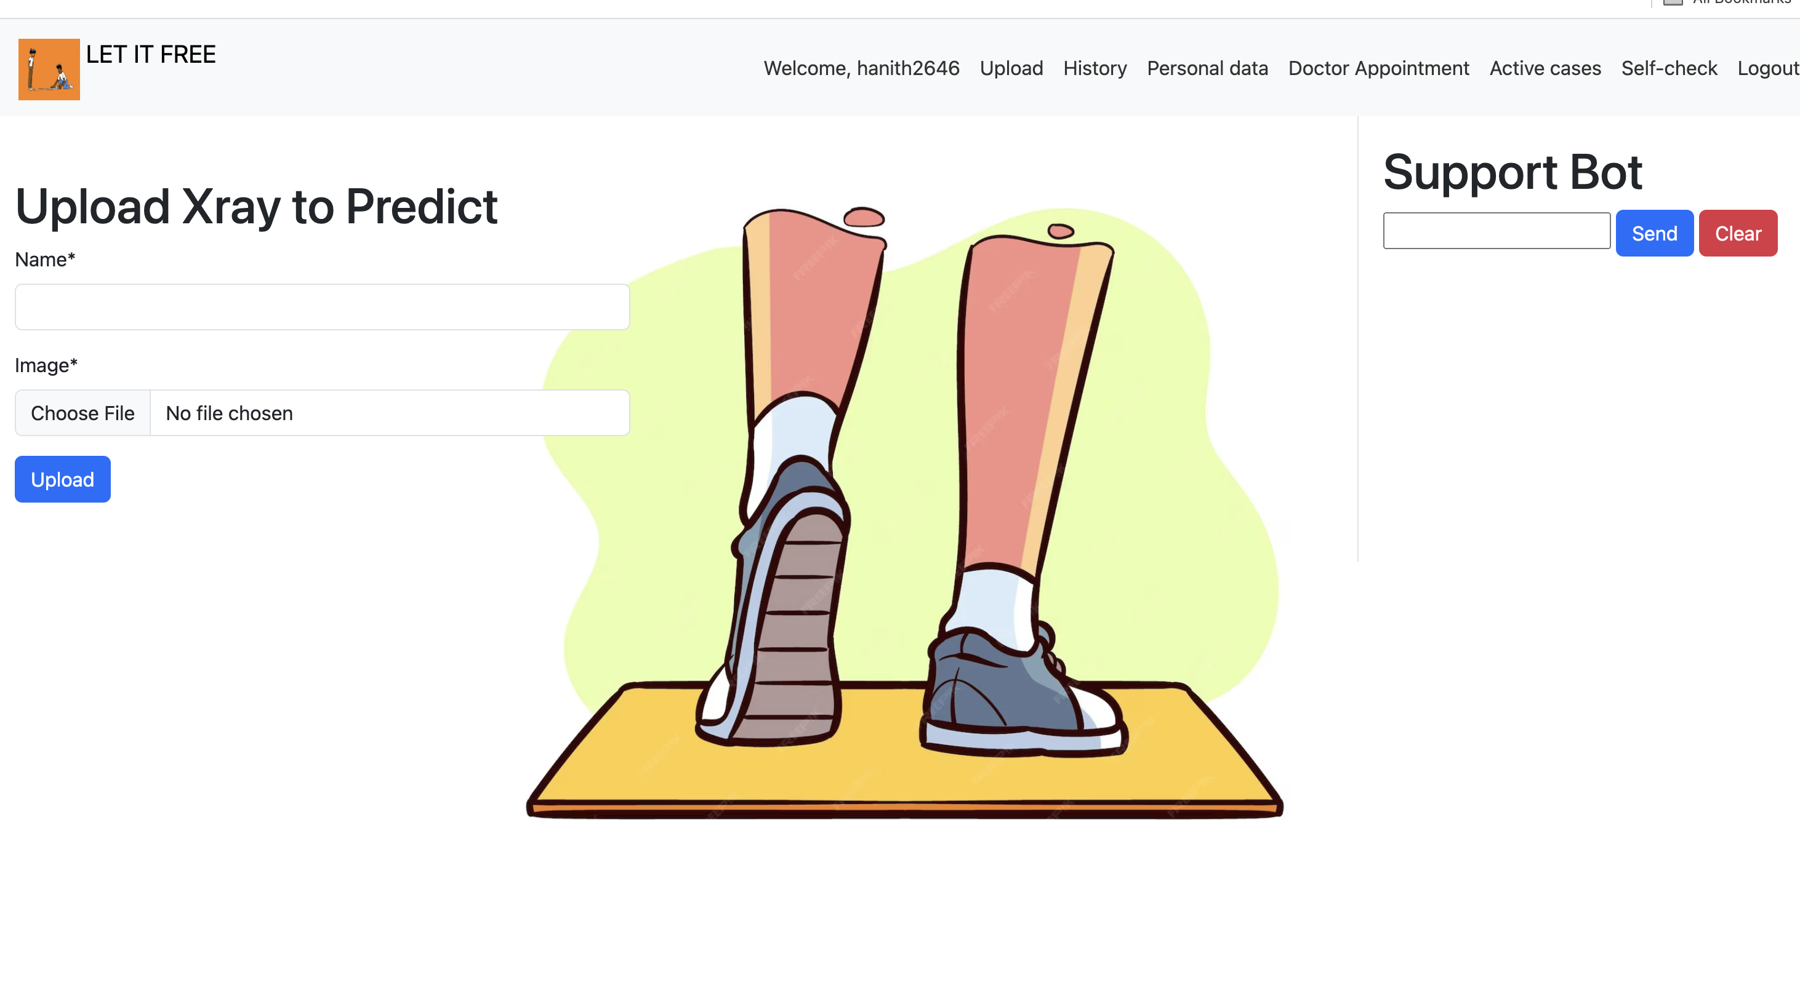
Home page
Features — A navigation header of some type is there on this homepage, and it provides supplementary links that will take us to the many locations where we are arranged. And uploading of the Xray is included by default of the starting page of the X-ray.

Slide 62
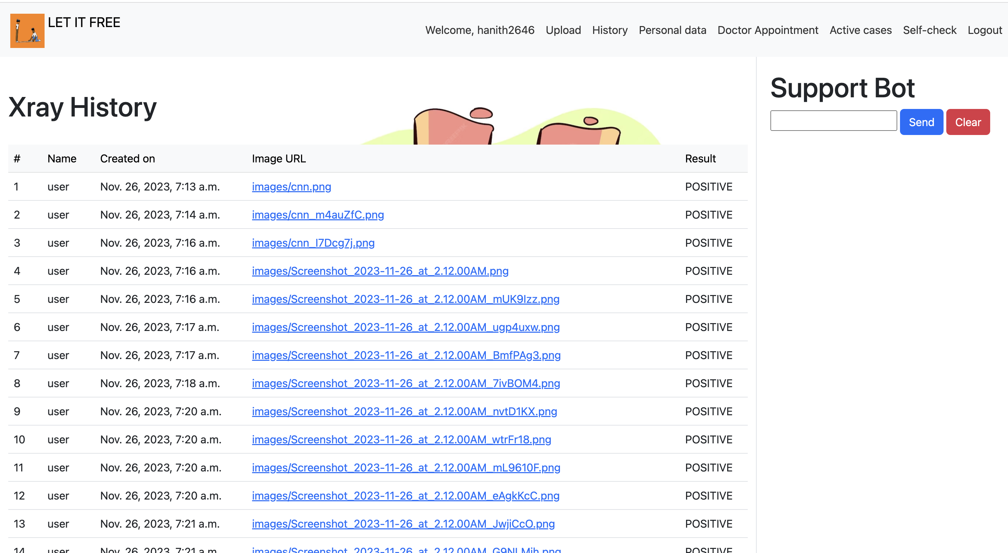
History page
Features- This page serves as a record of the uploaded x-ray, which will be preserved in the machine's local storage along with the user's name, the image's name, the result that was redacted while uploading, and the time of upload..

Slide 63
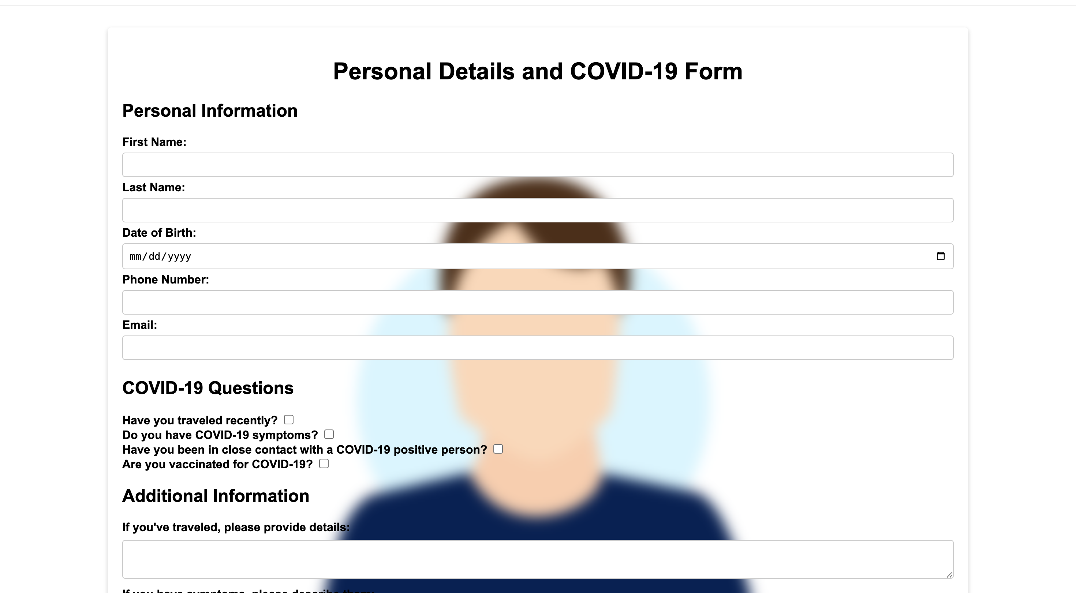
Personal information page
In this section of the site, users may enter their fundamental information (such as pre history of patient like heart problem, diabetes etc) and have it recorded in a firebase. Anyone interested in the user can see their profile history without ever having to touch them, thanks to this contact-free approach.

Slide 64
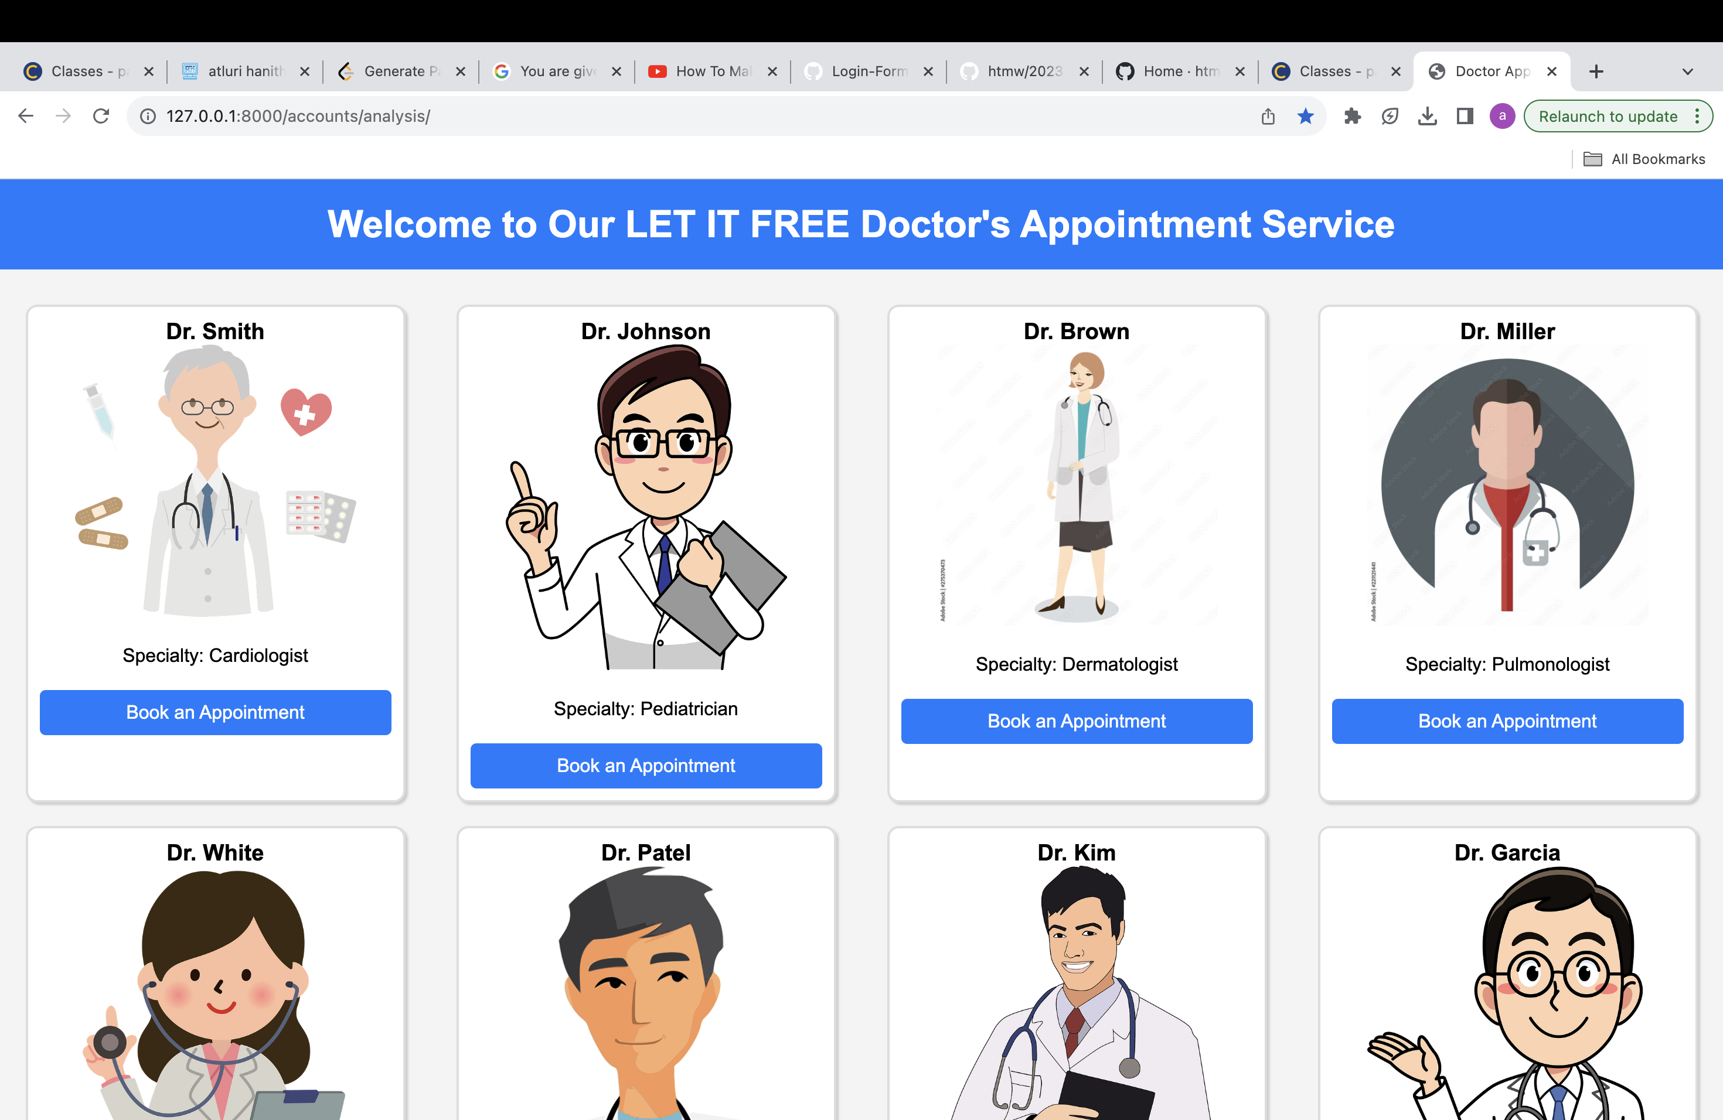
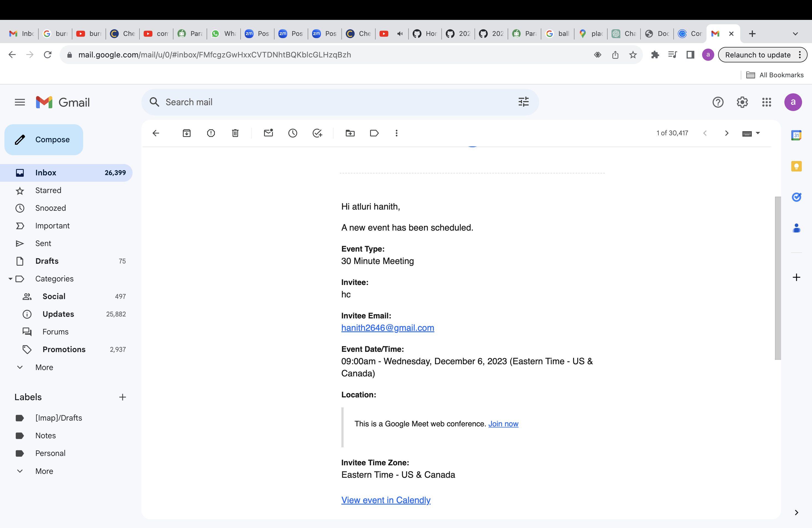
Doctor’s appointment page
Here in picture-01, we can see how to set up an appointment, and in the meanwhile, we can choose a certain doctor to execute a process, and in picture-02, we can see how to send the appointment information to our Gmail, so we can effortlessly relax.

Slide 65
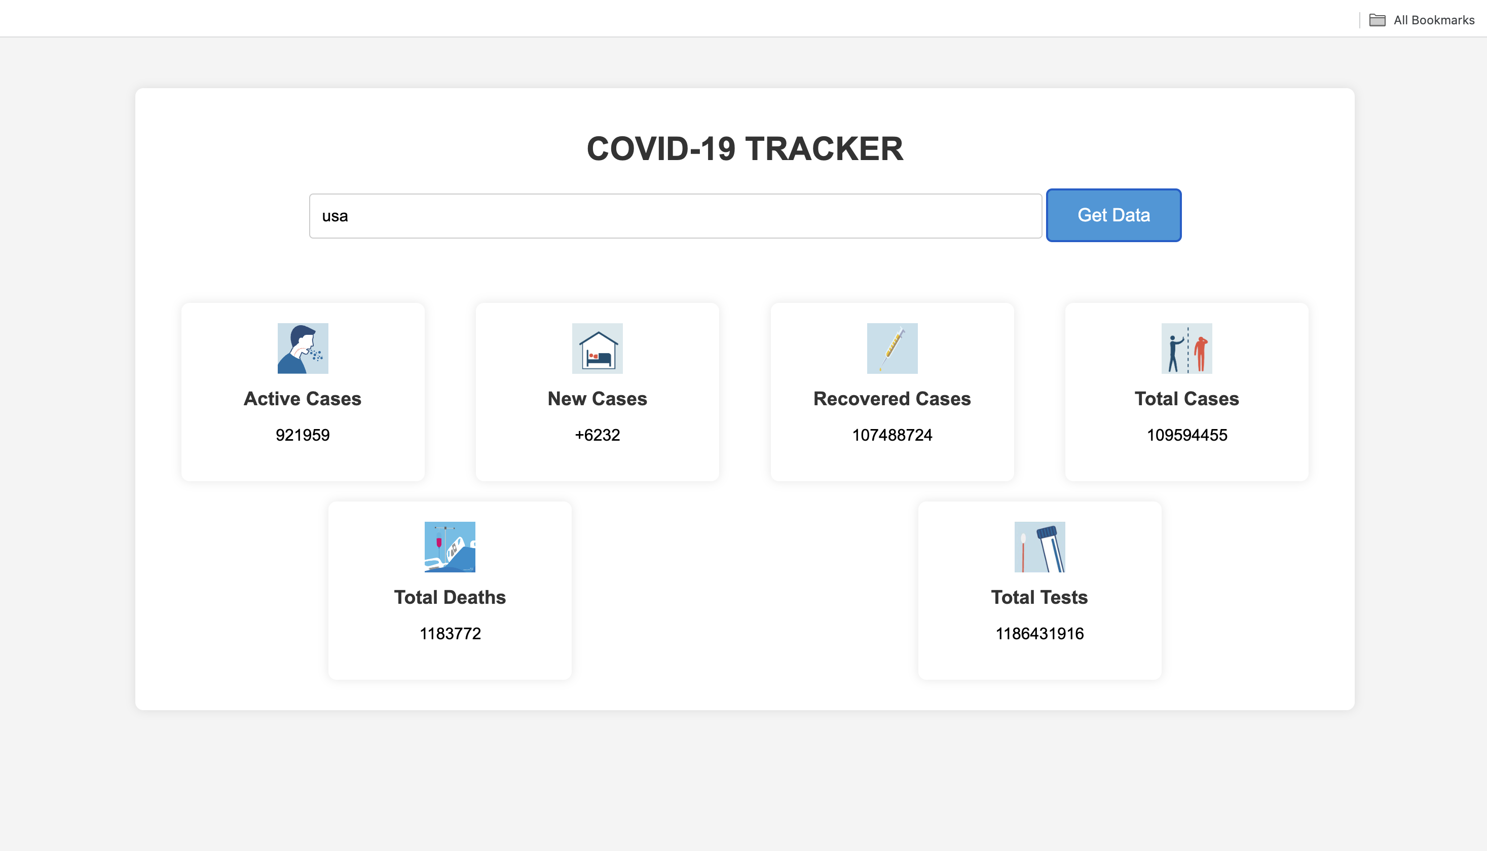
Real-time analysis of covid cases based on reagion
Here on the active cases page, we've integrated the rapid API to retrieve real-time data according to our queries. When we click on the get data tab, a variety of metrics are shown, including the number of active cases, new cases, recovered cases, total cases, total deaths, and total tests for the selected region. All of this data is available in the Rapid API.

Slide 66
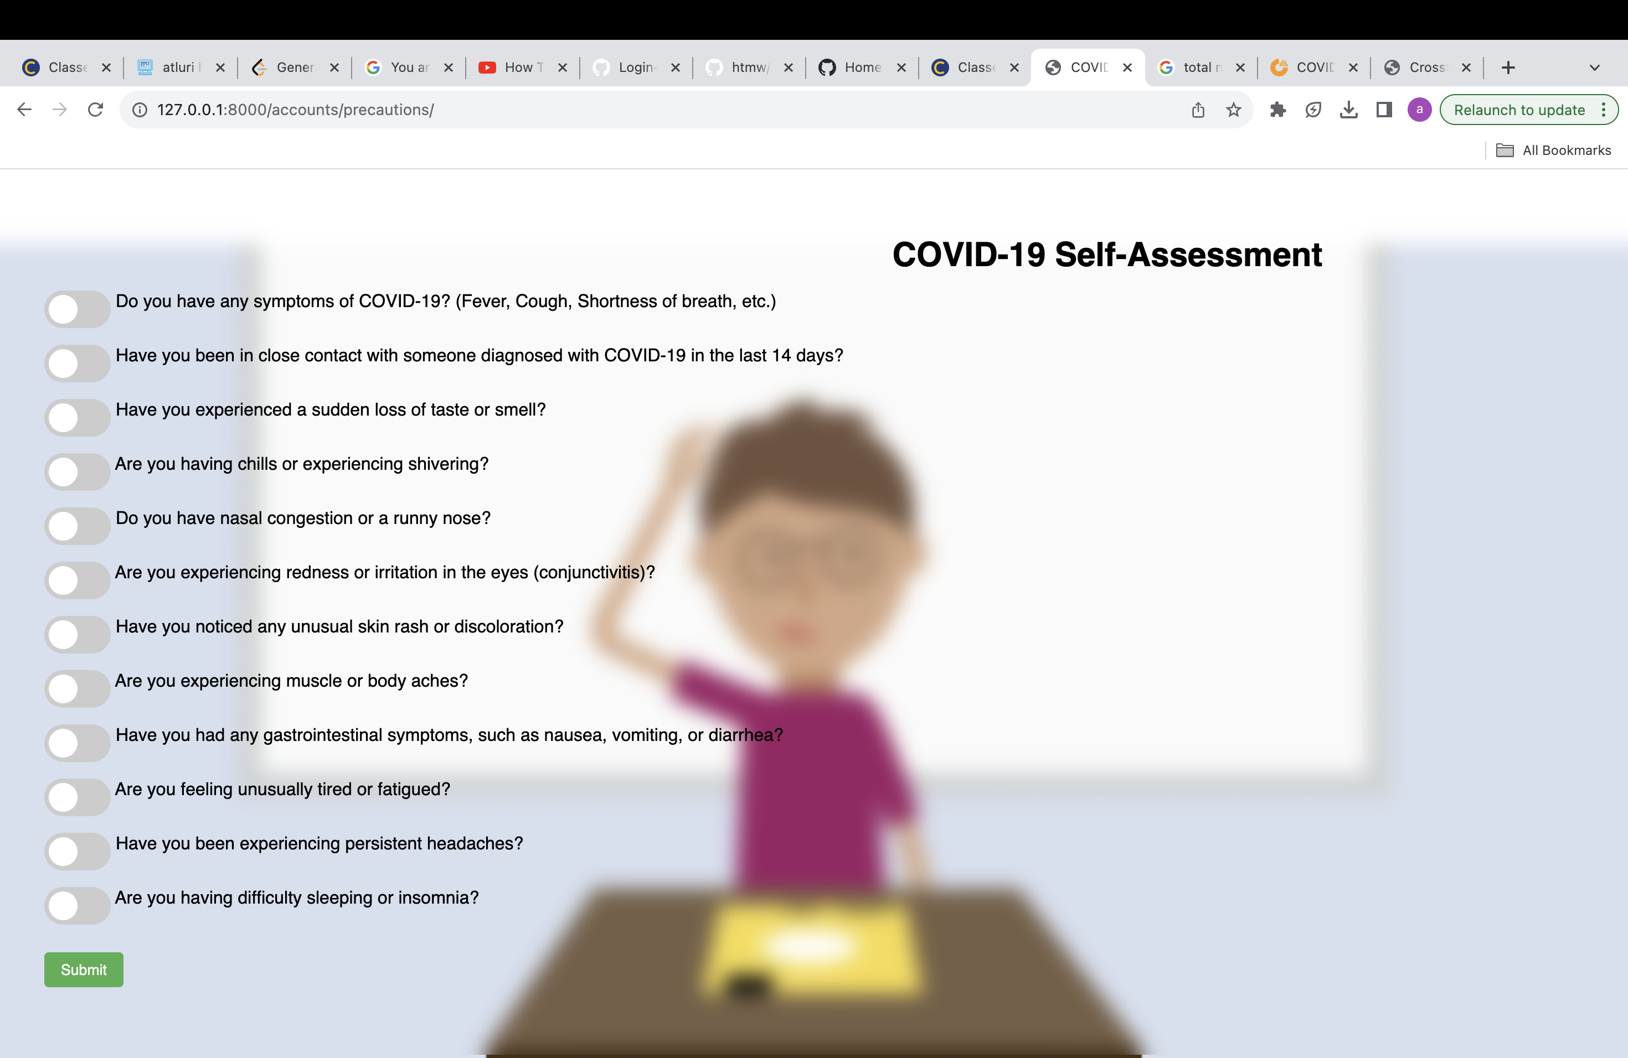
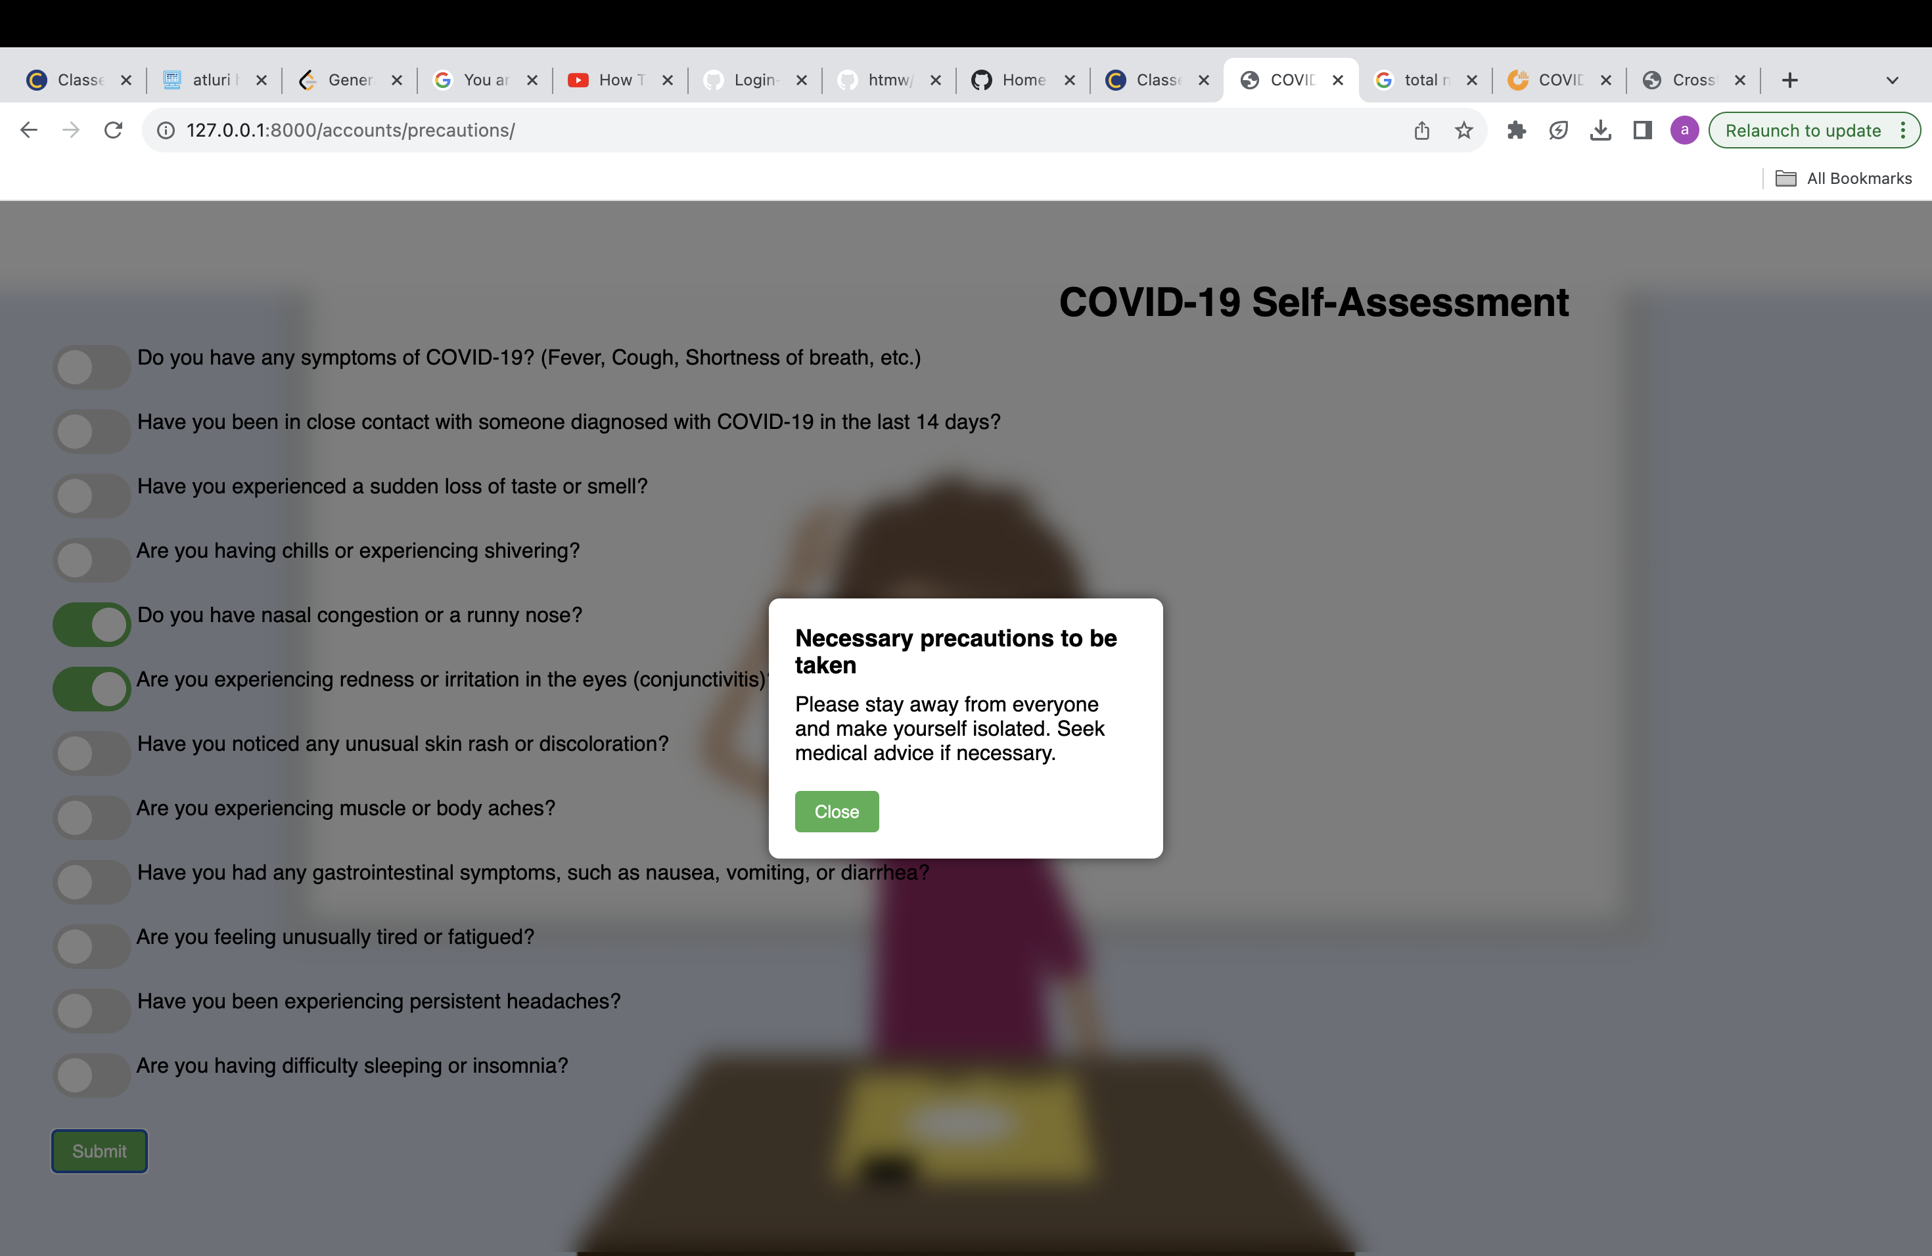
Self assessment page
The self-assessment page is where you'll see the warning that appears when the WHO's critical situation is stated. The results of the self-assessment will vary depending on what the user enters.

Slide 67
API SLIDES
Rapid API
Firebase API

Slide 68
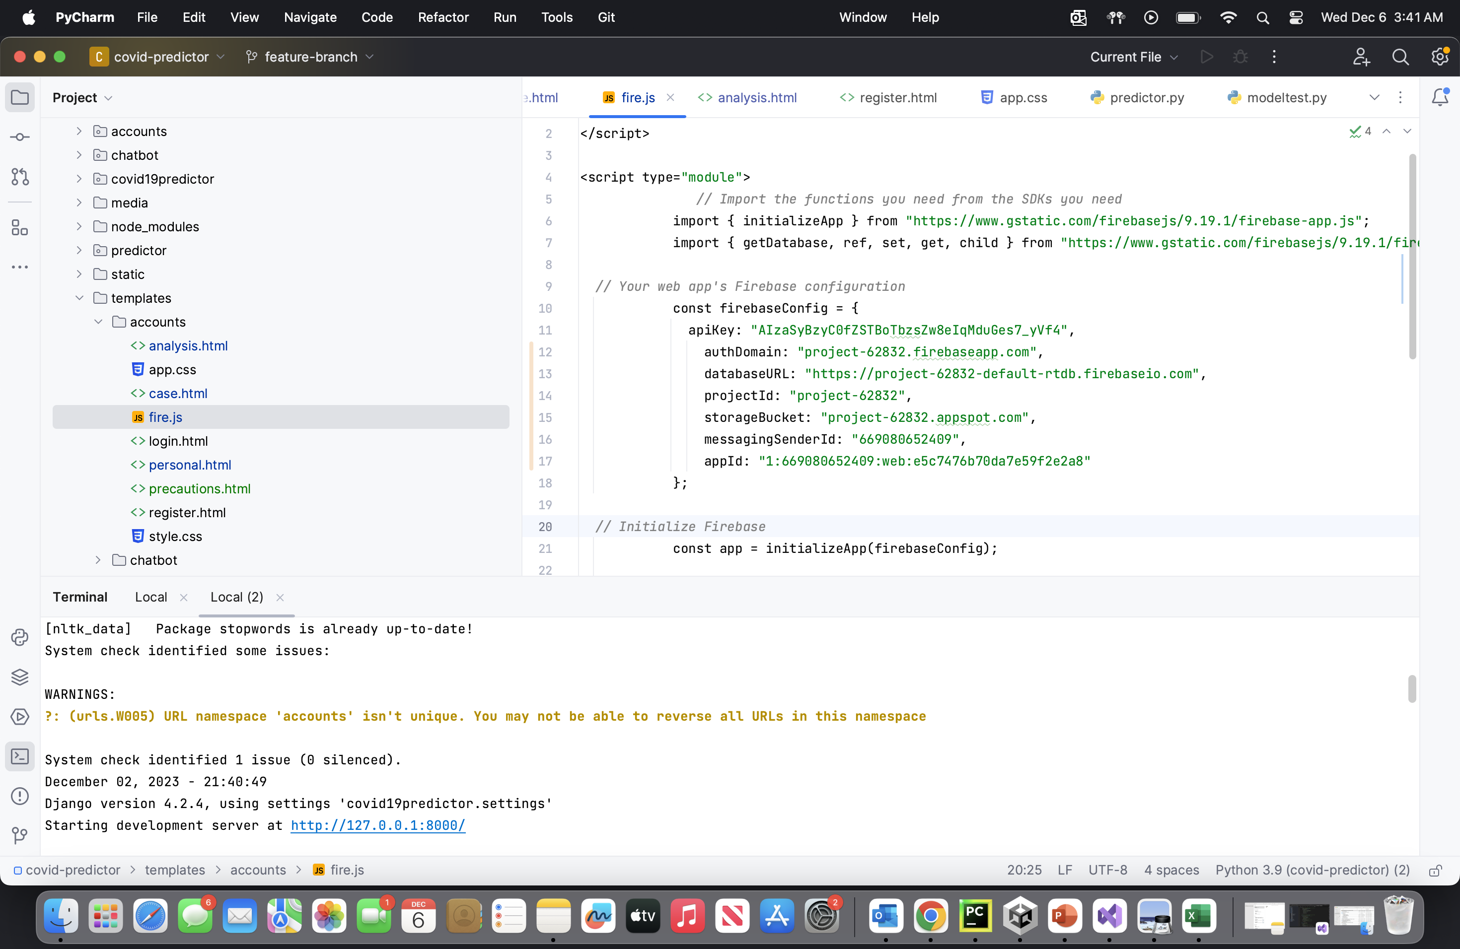
Firebase APi
Firebase Realtime Database API to interact with a Firebase database. It initializes the Firebase app with a specific configuration, connects to the database, and sets up an event listener for a submit button. When the button is clicked, it collects user input (username, email, and phone) and stores it in the Firebase database under the 'user' node. The code demonstrates a basic utilization of Firebase for real-time data storage, commonly used for user authentication and dynamic content in web applications.

Slide 69
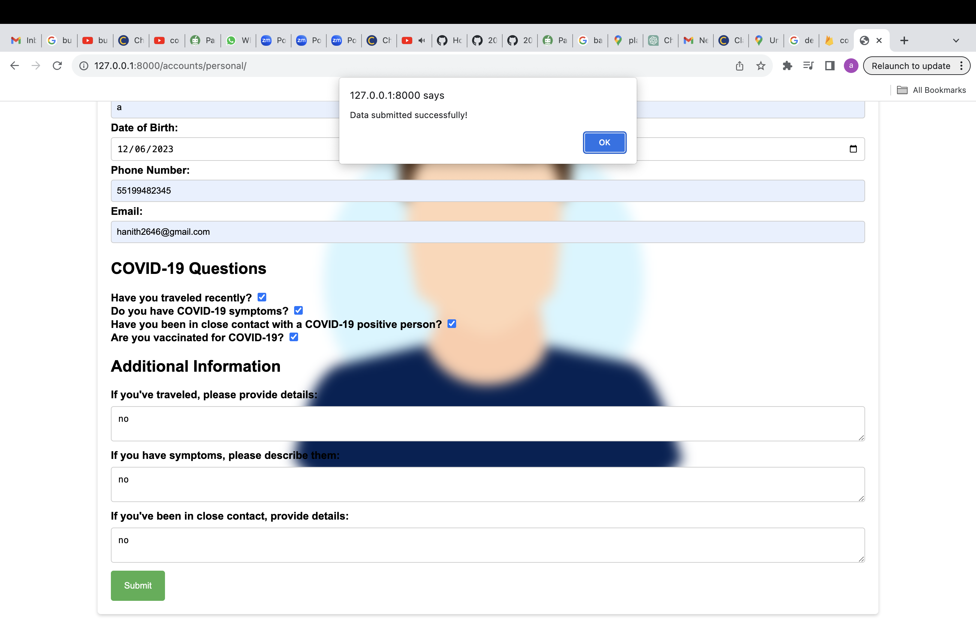
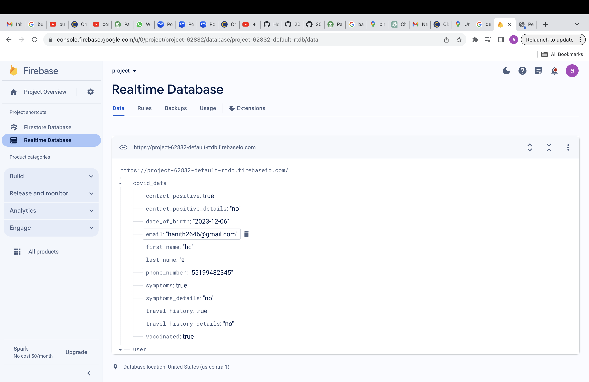
Firebase API
The data structure is to represent a user's COVID-19-related information. The API handles user details such as contact with a positive case, symptoms, travel history, and vaccination status. Utilizations include tracking and managing user health data, facilitating contact tracing, and supporting health-related decision-making based on the provided information. The structured data can be used in applications for monitoring and responding to individuals' COVID-19-related conditions. The data will be stored after the Submission from the user side only

Slide 70
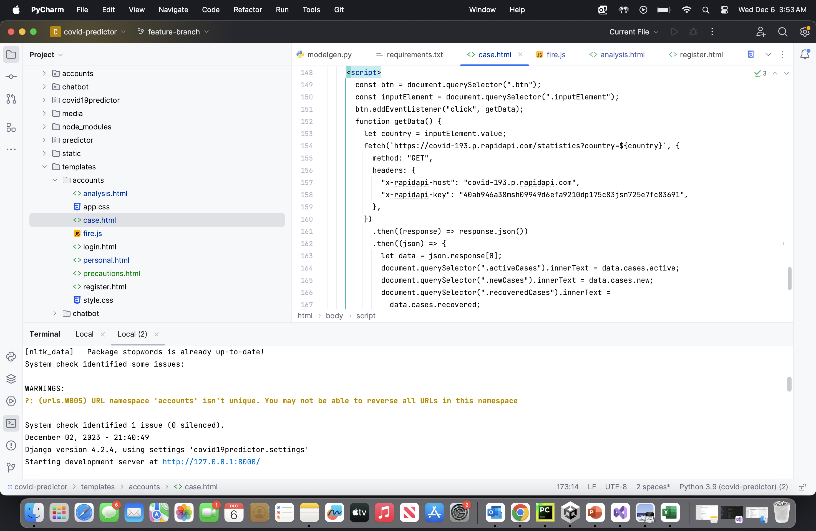
Rapid Api
JavaScript code utilizes the COVID-19 API to fetch and display statistics for a specified country. The API, hosted on RapidAPI, provides real-time data on active cases, new cases, recovered cases, total cases, total deaths, and total tests. The code employs the Fetch API to make an HTTP request to the COVID-19 API, and it dynamically updates HTML elements with the retrieved data, enabling users to track and visualize COVID-19 statistics for a specific country in a web application.

Slide 71
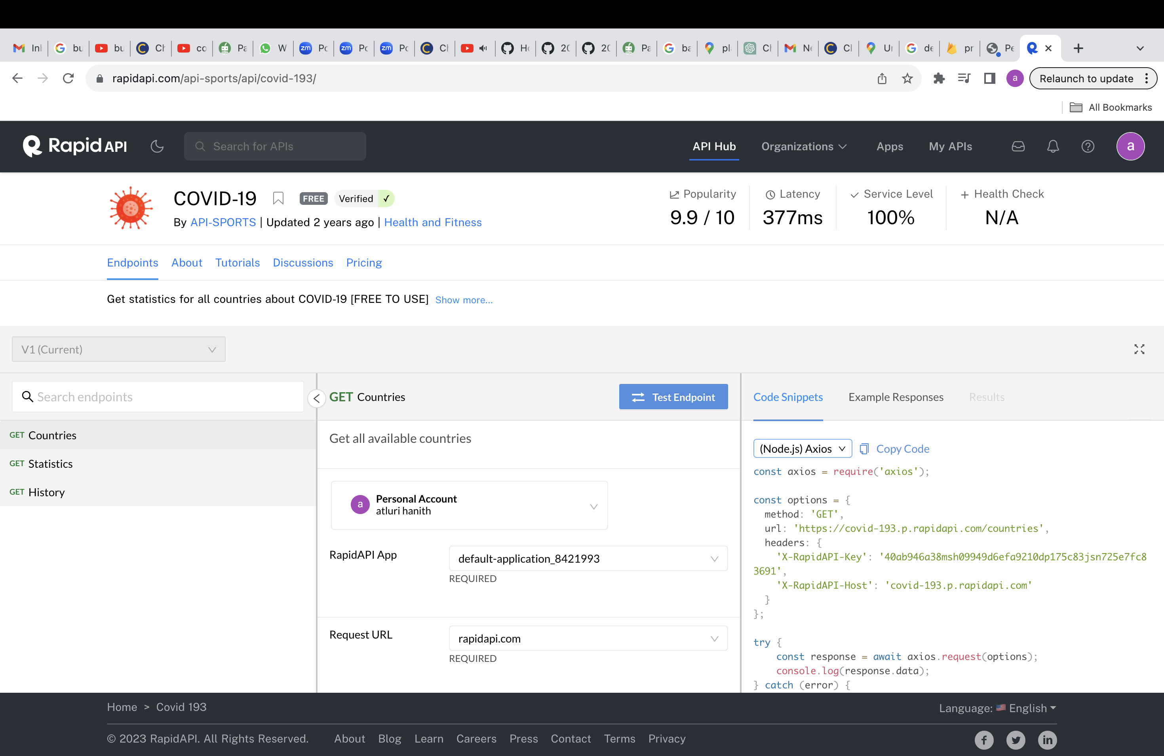
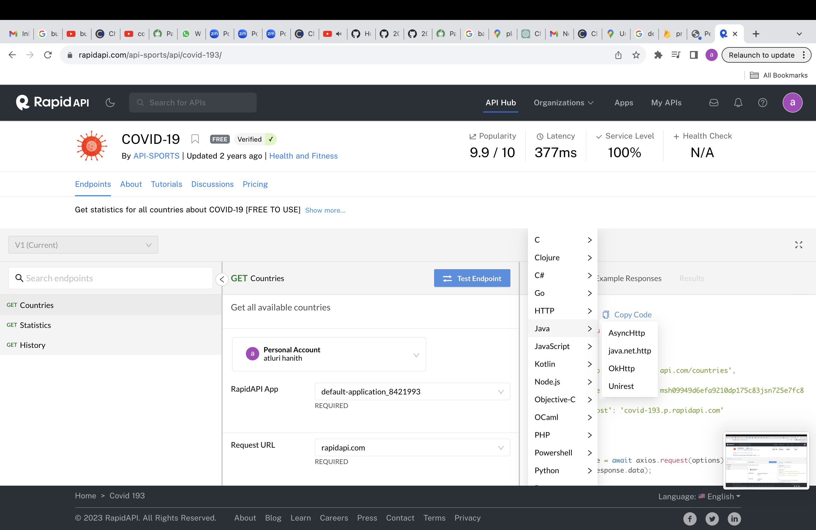
Rapid API
Node.js code utilizes the COVID-19 API to fetch a list of countries and their corresponding statistics. The API, hosted on RapidAPI, provides global COVID-19 data. The Axios library is employed to make an HTTP GET request, and the response is logged to the console. This code is useful for retrieving and displaying a comprehensive list of COVID-19 statistics for various countries in a Node.js environment, allowing developers to integrate this data into applications or analytics

Slide 72
Future scope
The medical field stands to benefit greatly from this software, which will allow for private use by physicians and provide quicker findings than manual verification.
In the event that another global infections were to strike, we may progressively enhance the use of no touch by using these applications.
Also, getting in touch with a doctor is simple, and there's no cost for a general exam, so doctors may see as many people as they need to.
In addition, there are a plethora of other services that may be integrated for the benefit of users and patients, such as self-assessment tools, among many others.

Slide 73

Live application Demo

Slide 74
GitHub link
Technical paper
Deployment manual
API Documentation

Slide 75

THANK YOU!

